Slide 1


Basic Pathology
Prof.(Vd) Narayan S. Jadhav
PRESIDENT (I/C), Medical Assessment and Rating Board (MARB)
MEMBER, BERISIM
National Commission for Indian Systems of Medicine
Government of India , New Delhi.

Slide 2
"Natural forces within us are the true healers of disease”
-Hippocrates. “The good physician treats the disease; the great physician treats the patient who has the disease”
-Sir William Osler. “The doctor of the future will give no medication, but will interest his patients in the care of the human frame, diet and in the cause and prevention of
disease.”
-Thomas Edison.
“It is health that is real wealth and not pieces of gold and silver”
-Mahatma Gandhi.
When diet is wrong medicine is of no use. When diet is correct medicine is of no need.
-Ayurvedic Proverb.

Slide 3
Ayurveda
Sankhya
Nyaya
Vasheshik
Buddha
Vedanta
Poorva Mimansa
Jain
Modern Medicine
Chemistry
Physics
Engineering
Social Science
Epidemiology
Molecular Biology
Life Science
Info Tech & Bio Technology.

Slide 4
Shastra & Science
Epistemology & Ontology
Disease
Illness
Structural
Health
Wellness
Systemic
Holistic
Reductionist
Aristotelian
Experimental
Analytical
Part-
(Cell-Tissue-Organ-System- Body)
Sankhya Philosophy
Experiential
Intiutive
Whole

Slide 5
Ayurveda Influence, Deliberate Ingnorance?
Hippocrates-Theory of Humours- Tridosha
Aristotal- Primordial Elements- Panchmahabhuta
Galen-Use of Tincture & Extracts- Kashayam & Ghana
Willem Osler-Individual Variation- Prakruti
Dean Ornis -Reversing CVDs -Samprapti Vighatan

Slide 6
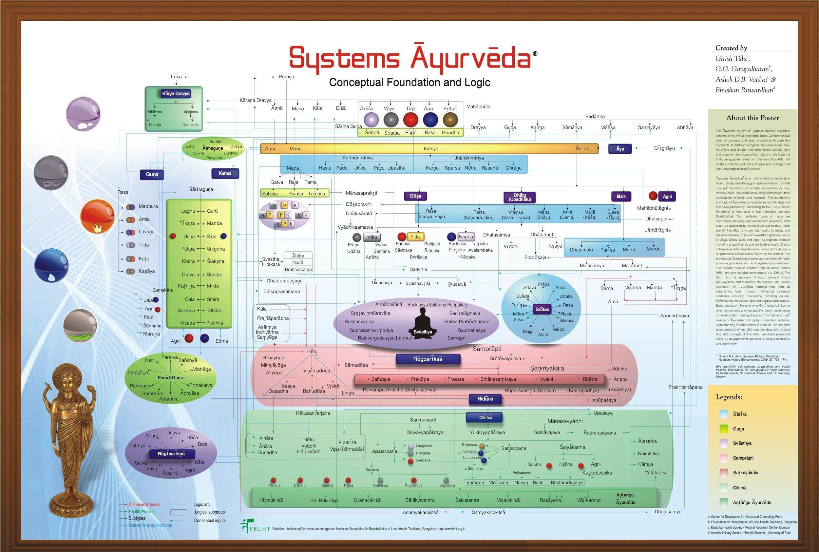

Slide 7
स्वास्थ व अस्वास्थ
विपत् भाव (विषमावस्था)
विषमदोष
मंद-तीक्ष्ण-विषमाग्नि
धातुनिर्माण व पोषण मे बाधा
मल घटक व उत्सर्जन् क्रिया प्रभावित्
अप्रसन्न मन इन्द्रि्यादि
( रुग्णावस्था/ विकारावस्था)
संपतभाव (साम्यावस्था)
समदोष
सम्यक् अग्निकर्म
यथोचित् धiतुनिर्माण
यथोचित मलो्त्पत्ति व मलोत्सर्जन
प्रसन्न मन इन्द्रियादि
( स्वस्थावस्था)

Slide 8
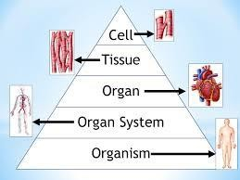
Tridosha
•
•
Dhatu
•
Upadhatu
•
Mala
Level of Organization
दोषधातमलमूलं दि शरीरम ् ! सु.सू.५१/३

Slide 9
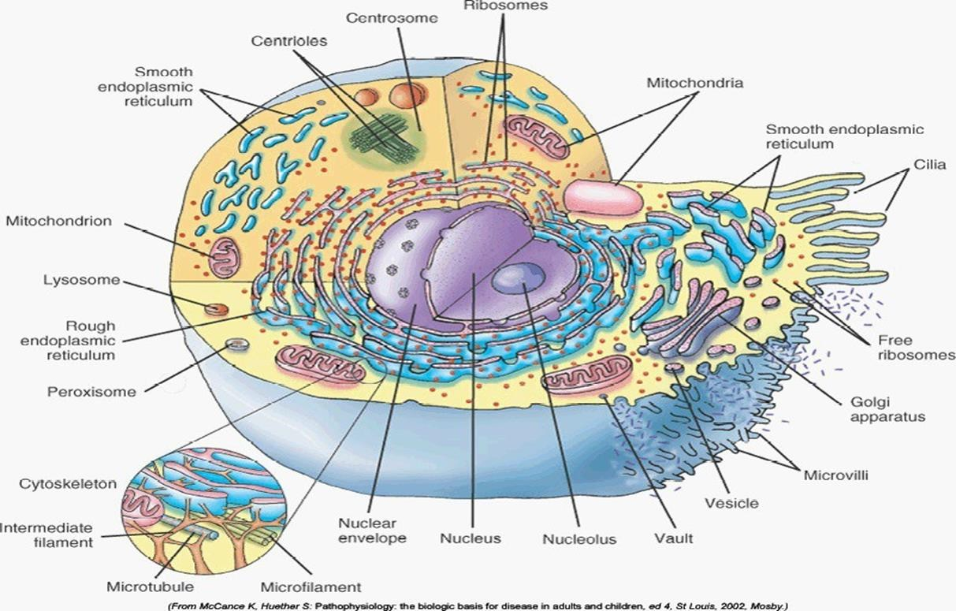
Tridosha –Single Cell
Nucleous –Vata Controller Contains genetic material
Mitochondria/Cytoplasmic Enzymes: Pitta.
Cellular Metabolism Production of Energy &Heat
Plasma Membrene/ER/Golgi Apparatus/
Kapha
Protection,Protein/Lipid Synthesis.

Slide 10
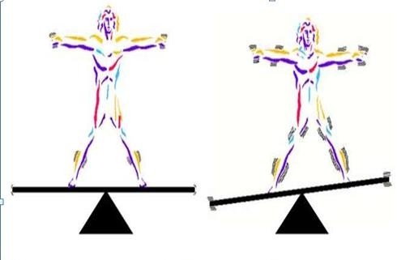

HOMEOSTASIS
समदोषः समाग्निश्च समधातुमलक्रियः |
प्रसन्िात्मग्े न्ियमिाः स्वस्थ इत्यभिधीयते |
Su Su 15/41
THE KEY TO – HEALTH & HAPPINESS
HOMEOSTASIS

Slide 11
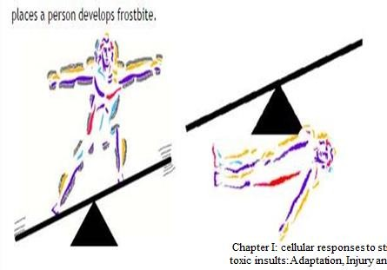
Subjection to stress
ADAPTATION
INJURY

Slide 12
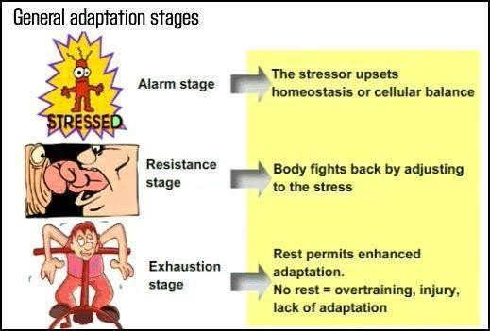
Demand or stimulation or Injurious agent
STRESS -

Slide 13
BASIC PATHOLOGY
Pathology : is the study of suffering / disease
Definition: Pathology is the study of disease — its causes, mechanisms, structural changes, and effects on the body.
Importance: It forms a bridge between basic science and clinical medicine.
रोगनिदान:
नानामुनीनां वचनैरिदानीं समासतः सद्भिषजां नियोगात् | सोपद्रवारिष्टनिदानलिङ्गो निबध्यते रोगविनिश्चयोऽयम् || ma ni 1/2
It involves basic medical sciences and clinical practice to investigates of cause [etiology ] of the disese and the mechanism of disease development [pathogenesis]

Slide 14
BRANCHES OF PATHOLOGY
The study of pathology is divided into general pathology and systemic pathology
General pathology is concerned with the reactions of cells and tissue to normal stimuli and inherited defects ,which are main causes of diseases
Systemic pathology examines the alterations in specialized organs and tissues that are responsible for disorders that involve these organs .
Basics terminology : Disease , etiology , pathogenesis ,diagnosis ,clinical manifestations –signs and symptoms ,prognosis , epidemiology

Slide 15
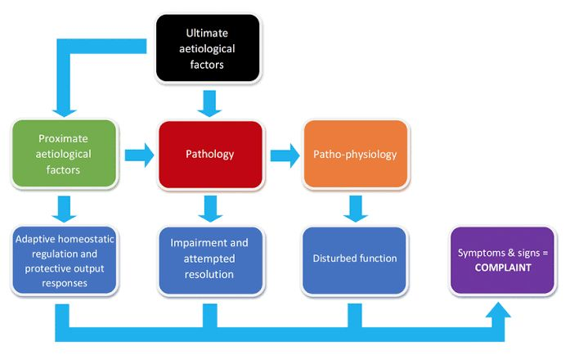
DISEASE AND ITS ASPECTS
Disease is a condition in which the presence of an abnormality of the body causes a loss of normal health
Idiopathic - no identifiable causes.
iatrogenic - occur as a result from medical treatment.
Congenital - disease existing at birth or before birth, involves in the development of fetus.
Acquired - develops post – fatally
Nosocomial - due to being in a hospital environments.
Aspects of Disease
The four aspects of a disease process that form the core of
pathology are its cause (etiology), the mechanisms of its development (pathogenesis), the biochemical and structural alterations, induced in the cells and organs of the body (molecular and morphologic changes), and the functional consequences of
these changes (clinical manifestations).

Slide 16
TECHNIQUES FOR THE STUDY OF PATHOLOGY :as per ayurveda
Roga Pariksha is the examination of Roga. Rogi Pariksha is the examination of Rogi.
रोगमादौ परीक्षेत ततोऽनन्तरमौषिम्| ततः कमातिषक्पश्चाज्ज्ज्ञानपूवंिमाचरेत्||Ch.su.20/20
A physician should first of all diagnose the disease and then he should select proper medicine. Thereafter, he should administer the therapy applying the knowledge of the science of medicine.

Slide 17
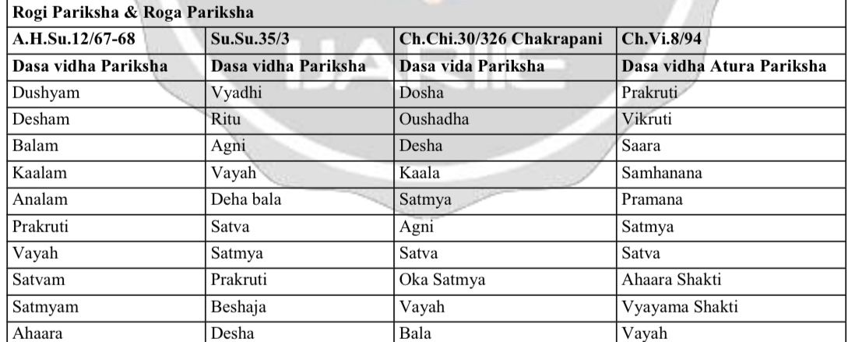
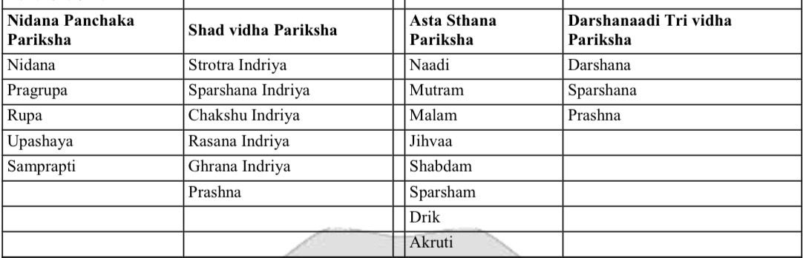

Slide 18
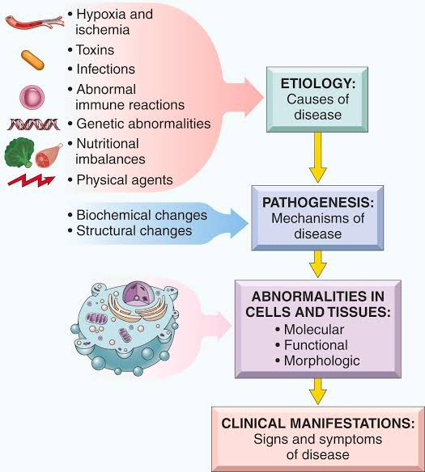
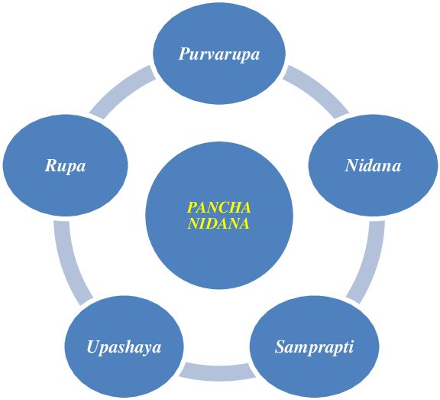
निदानं पूर्वरूपाणि रूपाण्युपशयस्तथा | सम्प्राप्तिश्चेति विज्ञानं रोगाणां पञ्चधा स्मृतम् ||४|| (वा. नि. अ. १) |
सेतिकर्तव्यताको रोगोत्पादकहेतुर्निदानम्|[etiology]
भाविव्याधिबोधकमेव लिङ्गं पूर्वरूपम्|
उत्पन्नव्याधिबोधकमेव लिङ्गं रूपम्” इति लक्षणम्|
सुखावहं सुखकरमुपशयं
यथादुष्टेन दोषेण यथा चानुविर्सपता | निर्वृत्तिरामयस्यासौ सम्प्राप्तिर्जातिरागतिः ||१०|| (वा. नि. अ. १) |
[सङ्ख्याविकल्पप्राधान्यबलकालविशेषतः |]

Slide 19
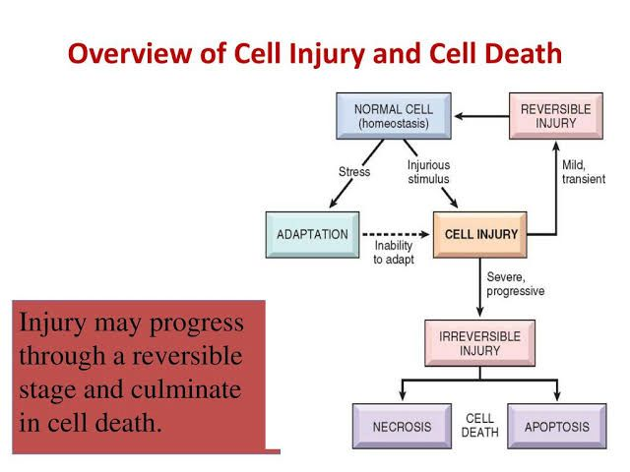
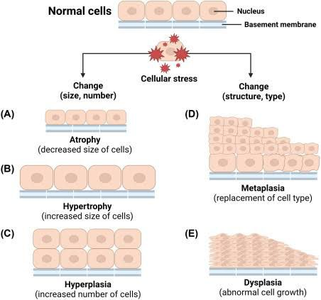

Slide 20
IMMUNOPATHOLOGY IN ayurveda:
Immunopathology in Ayurveda is primarily understood through the concepts of Agni (digestive and metabolic fire), Aama (undigested metabolic waste), Ojas (vital essence and immunity), and Vyadhikshamatva (disease resistance).
Immunity is not viewed as a single system but rather as an integrated function of all bodily systems working in harmony.
When Agni becomes impaired due to improper diet, stress, or environmental factors, it leads to the formation of Aama, a toxic residue that circulates in the body and obstructs normal physiological functions.
This Aama becomes the root cause of many disorders, particularly autoimmune diseases where the body’s own dhatus (tissues) are attacked due to misrecognition, reflecting an imbalance in internal intelligence.

Slide 21
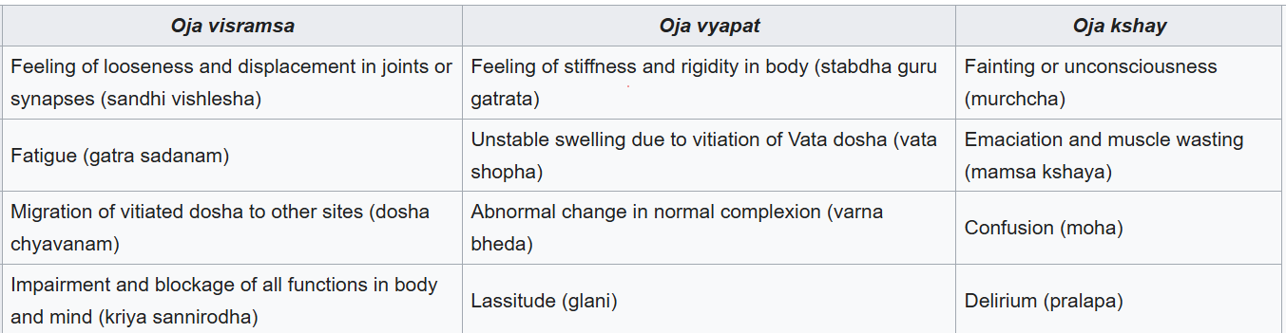
Ojas, derived as the essence of all seven dhatus, is considered the foundation of physical strength, mental clarity, and immune resilience. A decrease or disturbance in Ojas—known as Ojakshaya—leads to lowered immunity and susceptibility to chronic and recurrent illnesses.
In allergic or hypersensitive conditions, aggravated Kapha and Vata, along with circulating Aama, produce exaggerated responses to harmless substances.
OJA DUSHTI

Slide 22
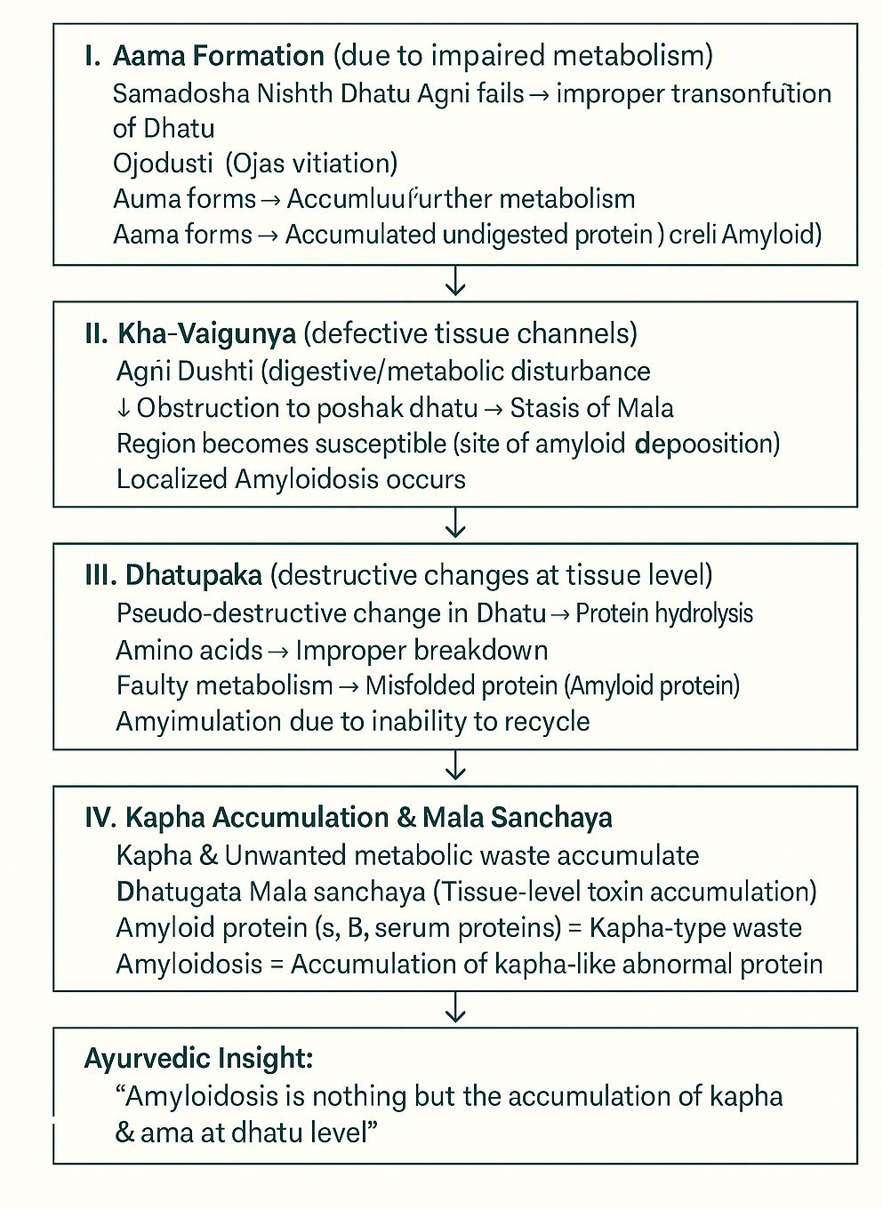
AMYLOIDOSIS
Amyloidosis is a group of disorders characterized by extracellular deposition of abnormal fibrillar proteins (amyloid) in various tissues and organs, leading to organ dysfunction.

Slide 23
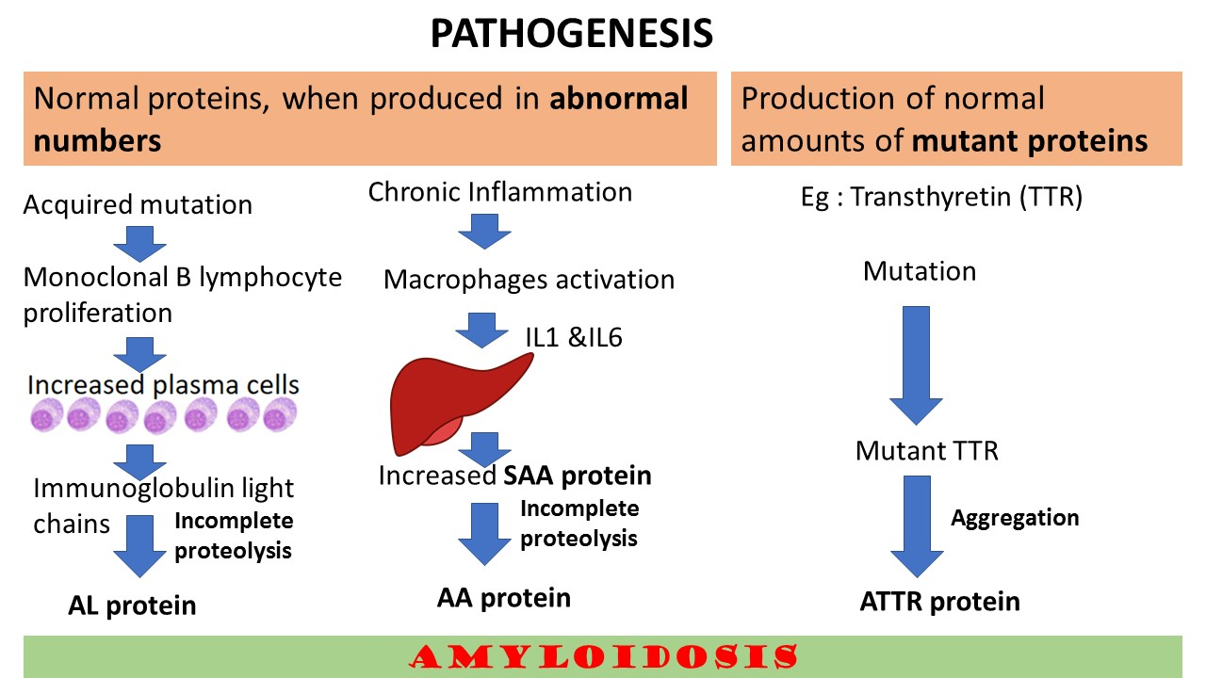

Slide 24
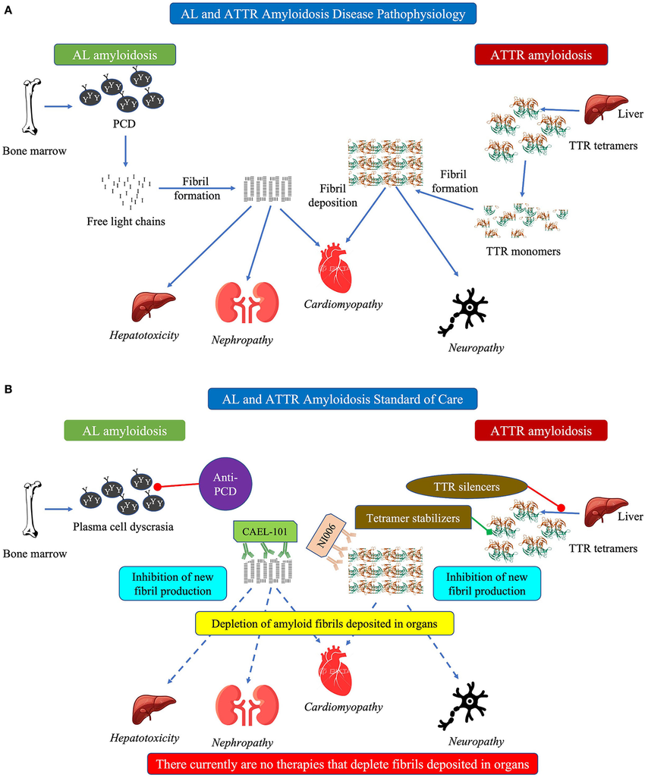
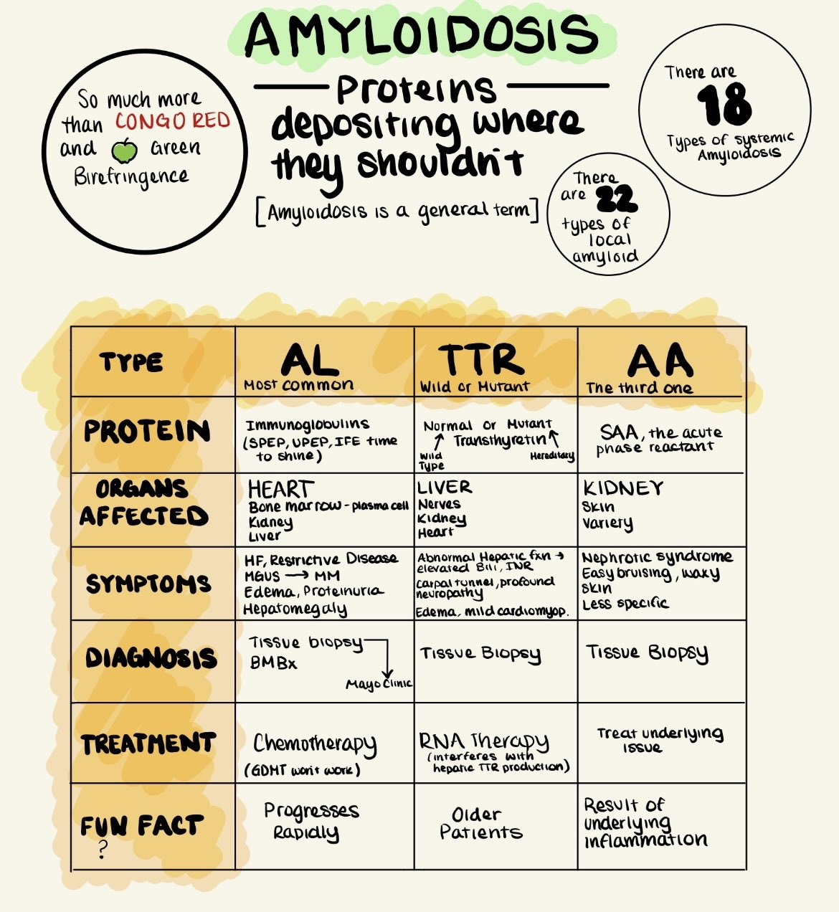

Slide 25
HAEMODYNAMIC DISODERS
Hemodynamic disorders are abnormalities in:
• Blood flow
• Blood volume
• Vascular resistance
• Coagulation mechanisms
These disturbances lead to ischemia, infarction, congestion, edema, hemorrhage, or shock—all of which impair organ structure and function. These are common pathways in many systemic diseases.

Slide 26
OEDEMA :
Mechanism: Fluid accumulation in interstitial spaces due to imbalance in Starling forces (↑ hydrostatic, ↓ oncotic pressure) or lymphatic obstruction.
Clinical Condition | Pathological Manifestation
Heart failure | Pulmonary edema → dyspnea, pink frothy sputum
Nephrotic syndrome | Anasarca due to protein loss → ↓ plasma oncotic pressure
Cirrhosis | Ascites due to portal hypertension + hypoalbuminemia
Lymphatic obstruction | (e.g. filariasis) Localized lymphedema, elephantiasis

Slide 27
Hyperemia & Congestion :
Hyperemia = active (arteriolar dilation)
Congestion = passive (impaired venous return)
Lung congestion (LHF) Capillary rupture → alveolar hemorrhage → hemosiderin-laden macrophages (“heart failure cells”)
Chronic liver congestion (RHF) Nutmeg liver: centrilobular necrosis, fibrosis → cirrhosis

Slide 28
Hemorrhage:
Mechanism: Blood loss due to vessel rupture, platelet defect, or coagulation failure
Example | Disease Manifestation
Ruptured berry aneurysm | Subarachnoid hemorrhage → sudden headache, coma
Peptic ulcer erosion GI bleeding | → hematemesis, melena
DIC Widespread microvascular bleeding | → multiorgan failure

Slide 29
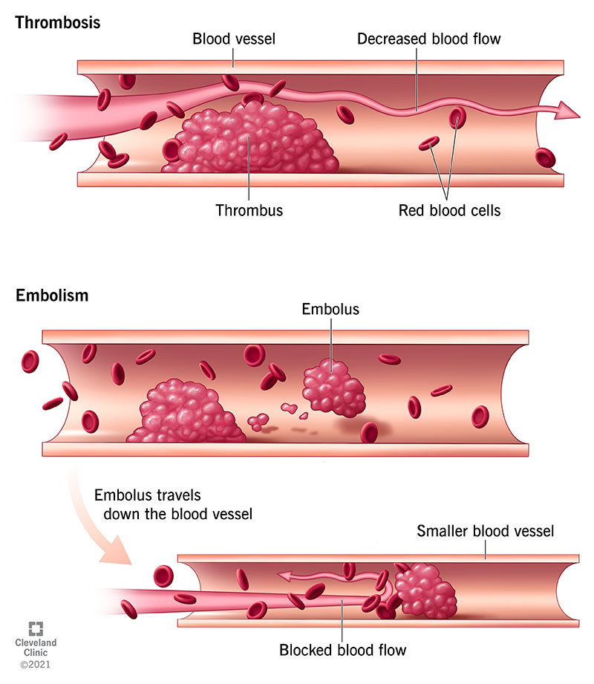
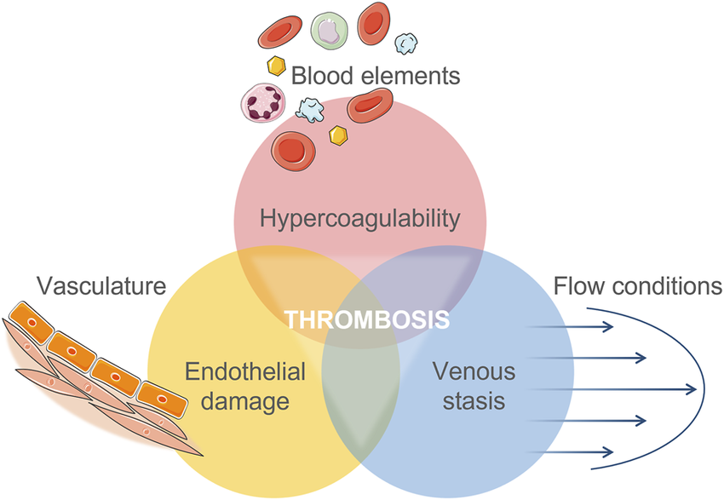
Thrombosis
Mechanism: Pathological clot formation inside vessels (Virchow’s triad – endothelial injury, stasis/turbulence, hypercoagulability)
Condition | Consequence
DVT | Risk of pulmonary embolism
Atherosclerosis | Plaque rupture → coronary thrombosis → MI
Atrail Fibrillation | Atrial thrombus → cerebral embolism → ischemic stroke

Slide 30
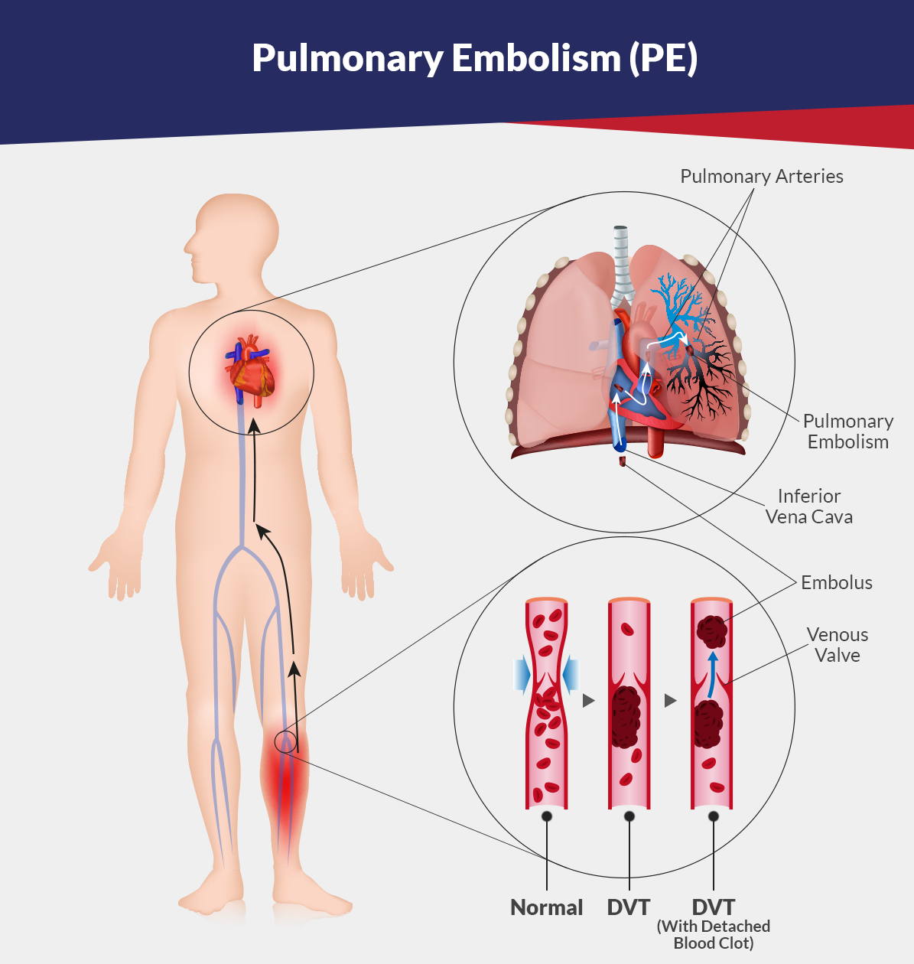
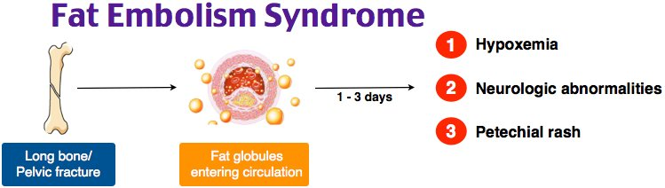
Embolism :
Mechanism: Detached intravascular mass (solid, liquid, or gas) that occludes downstream vessels.

Slide 31
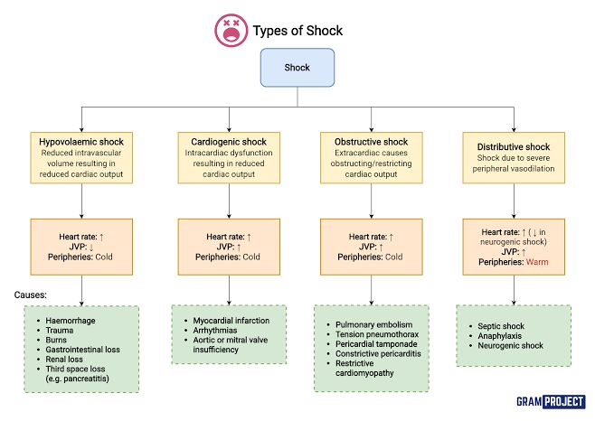
SHOCK
Mechanism: Systemic hypoperfusion → cellular hypoxia → multi-organ failure

Slide 32
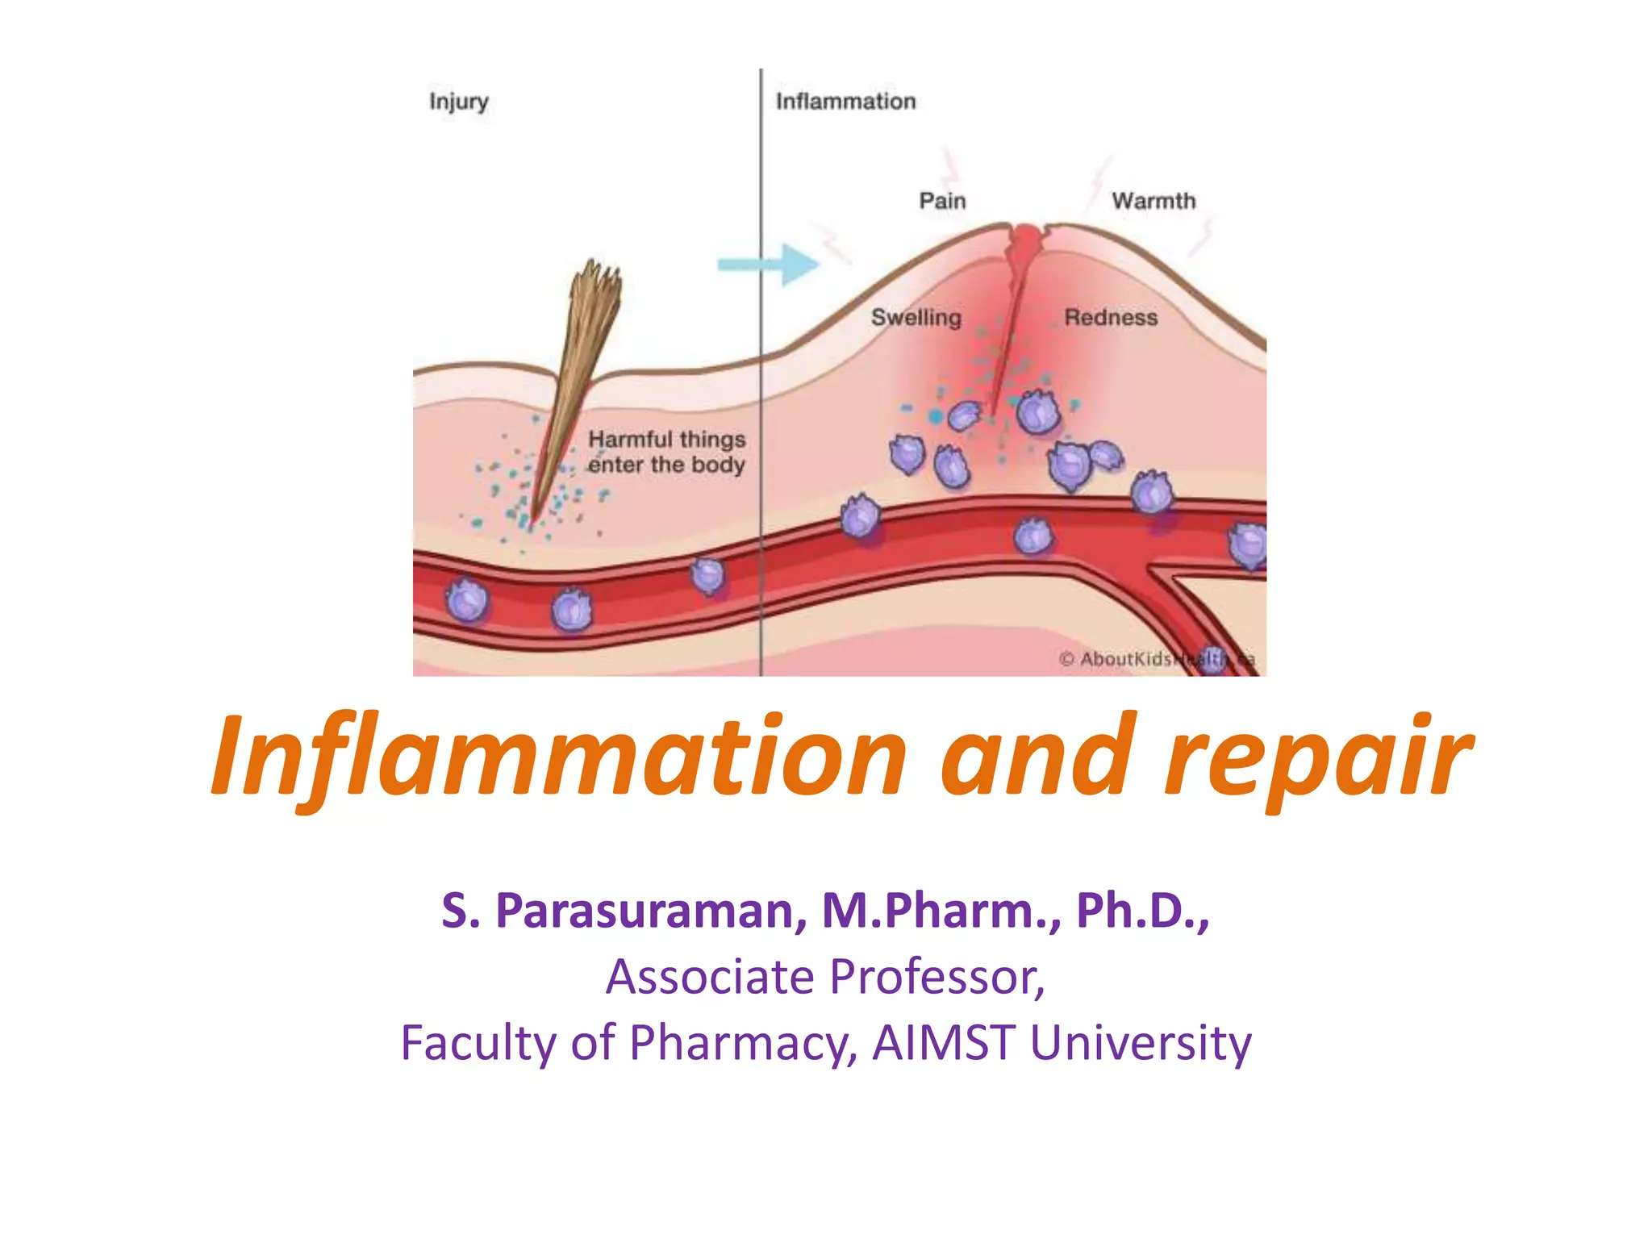
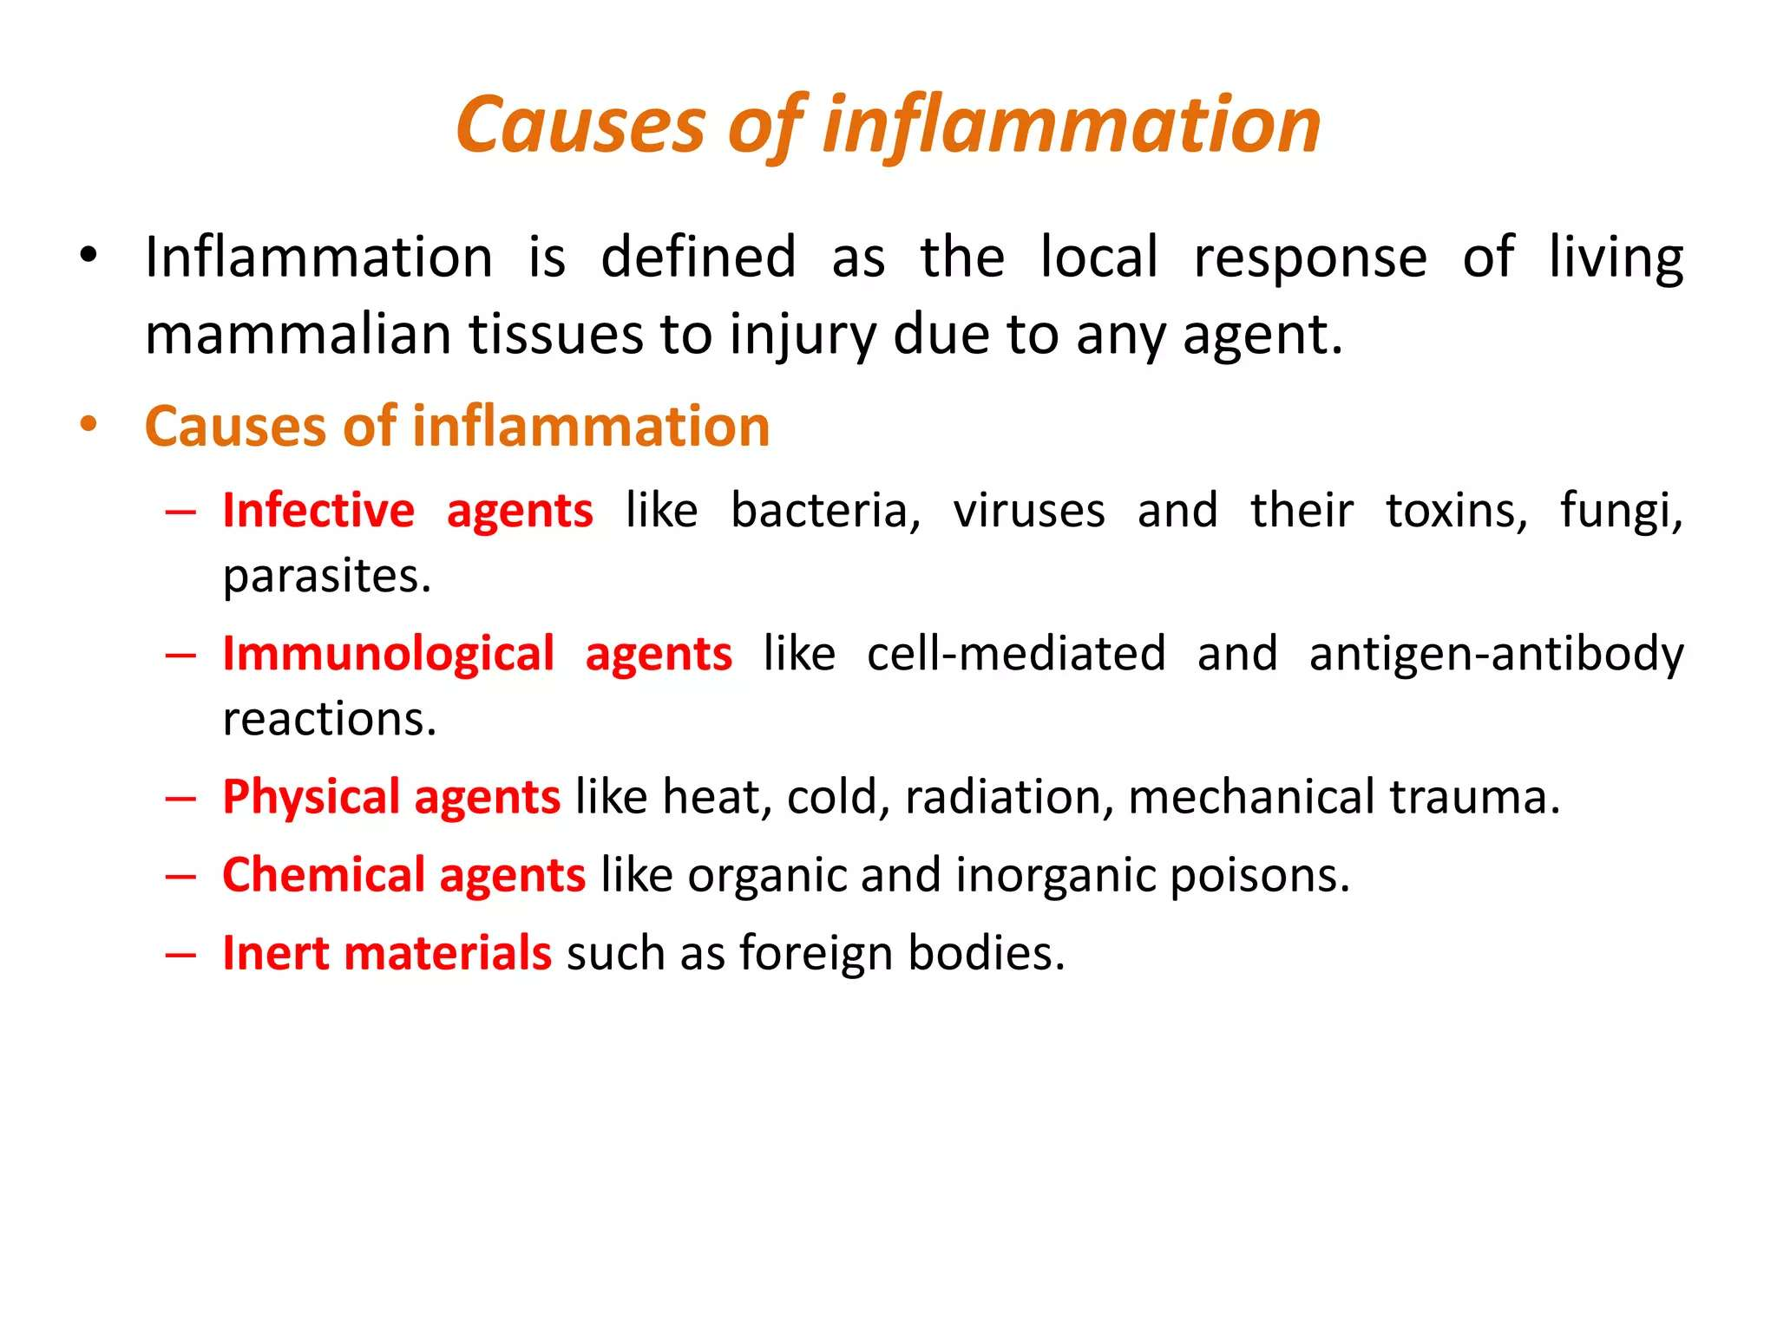
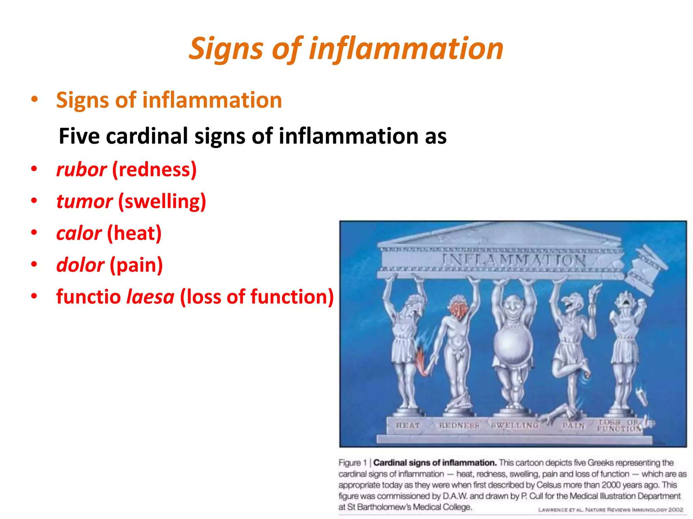
INFLAMMATION AND HEALING :
Signs of Inflammation

Slide 33
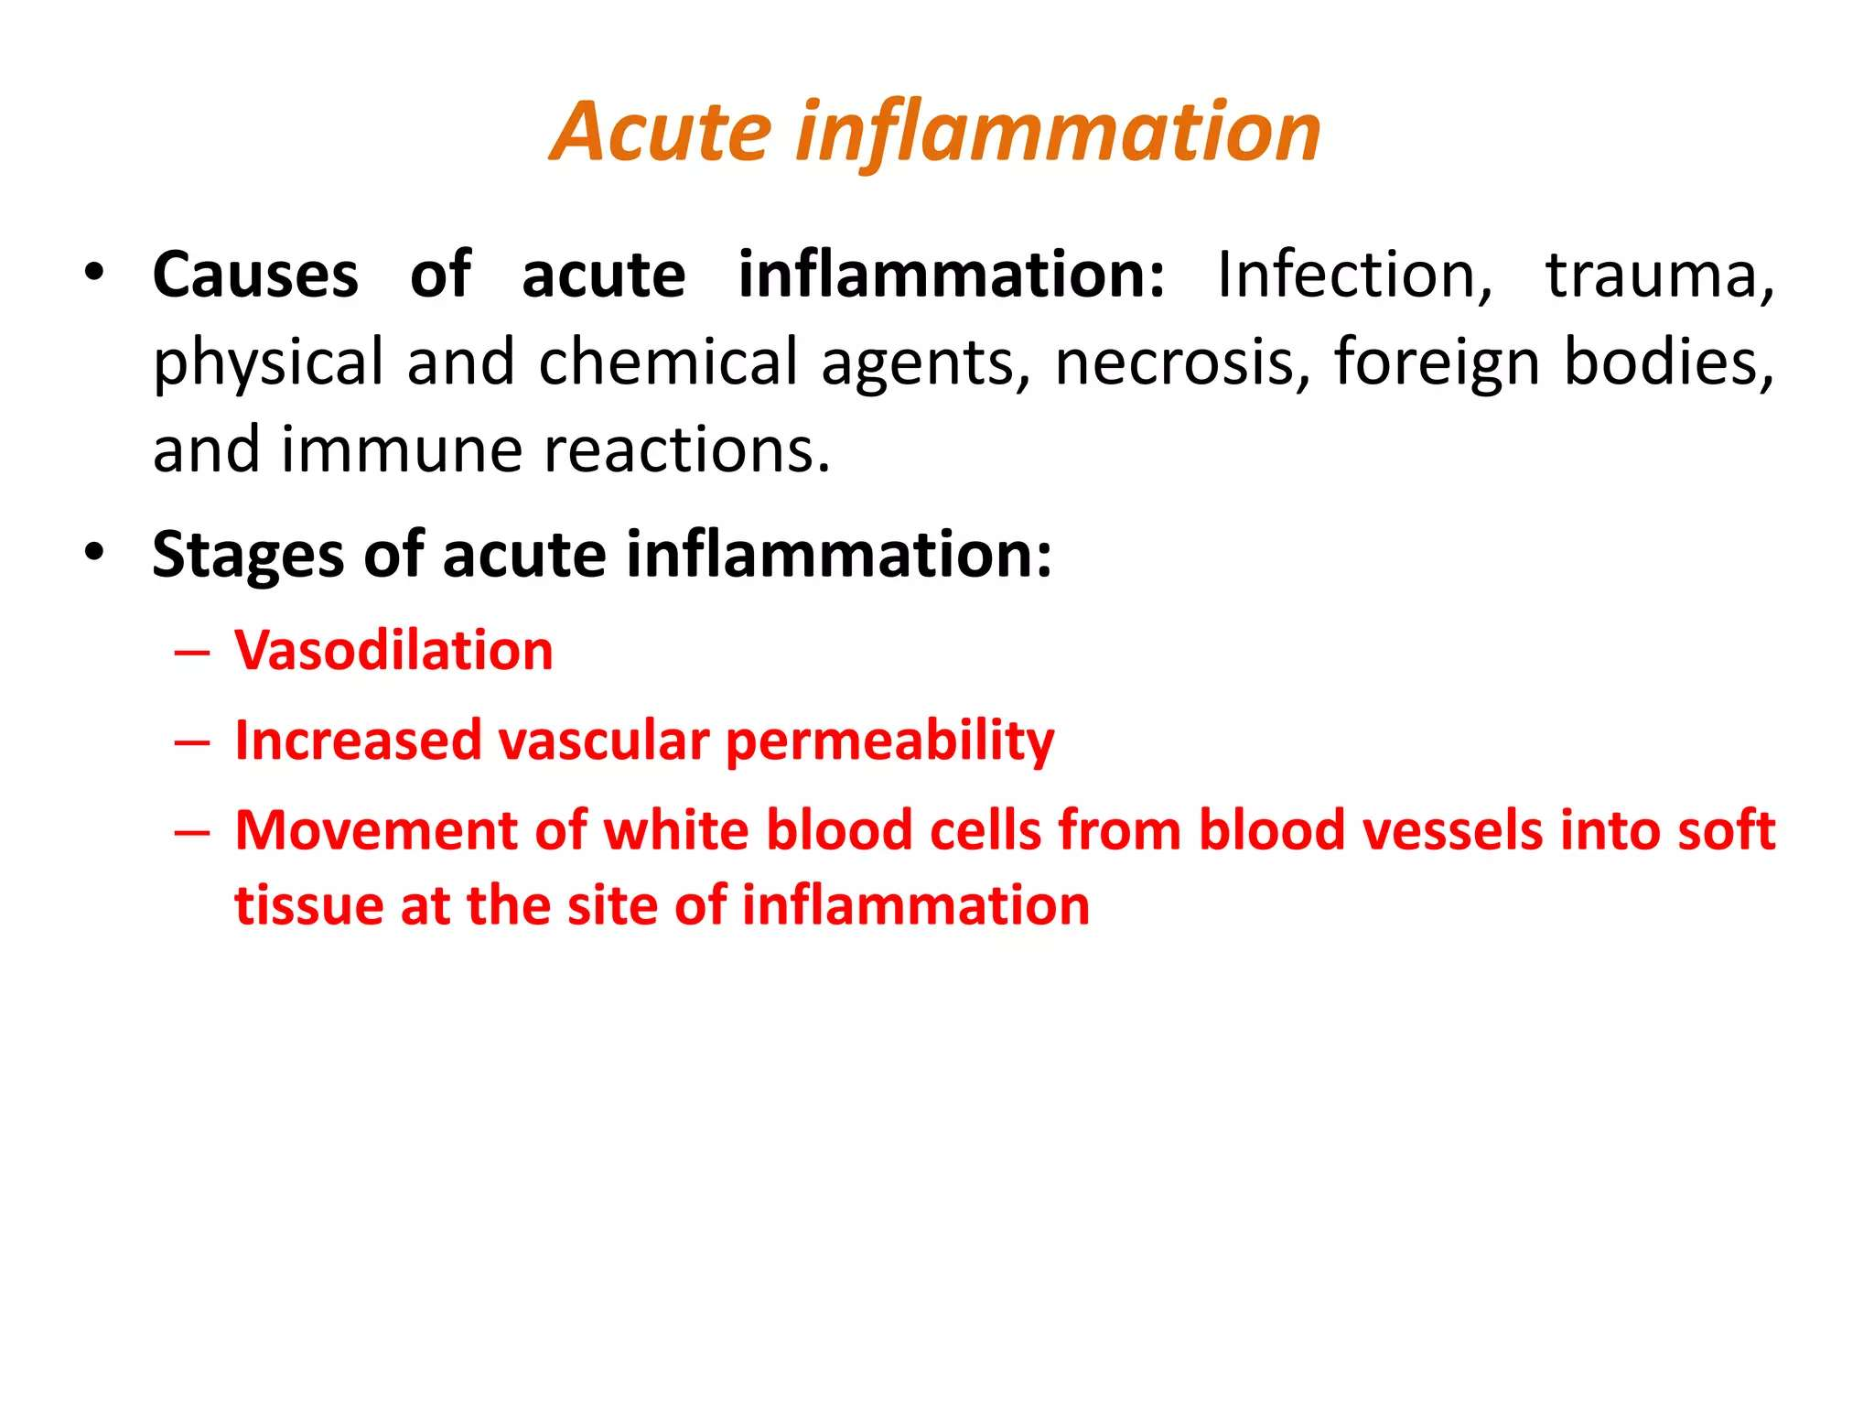
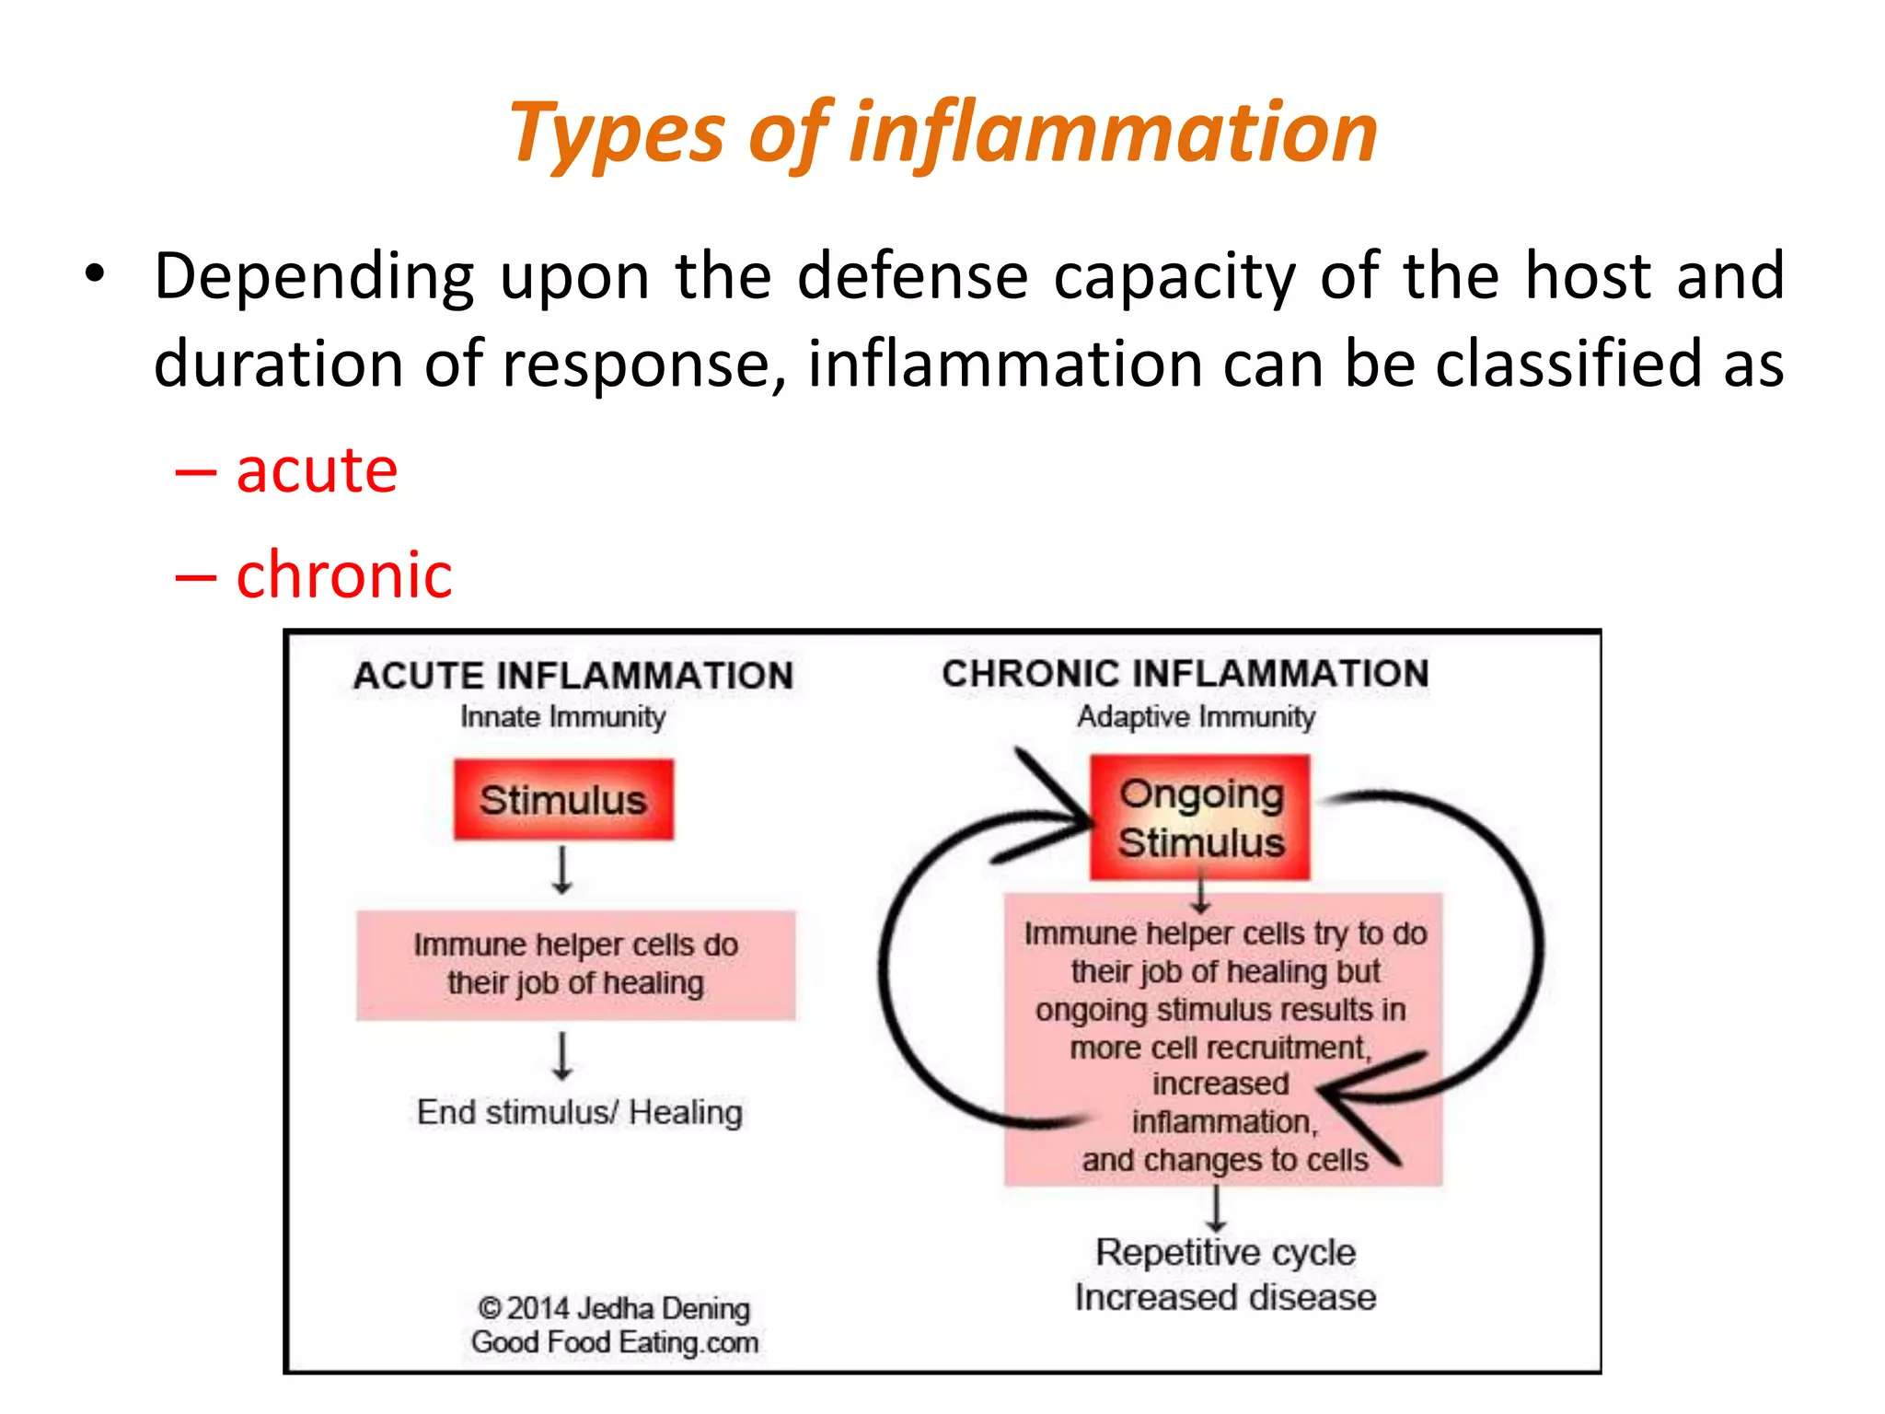
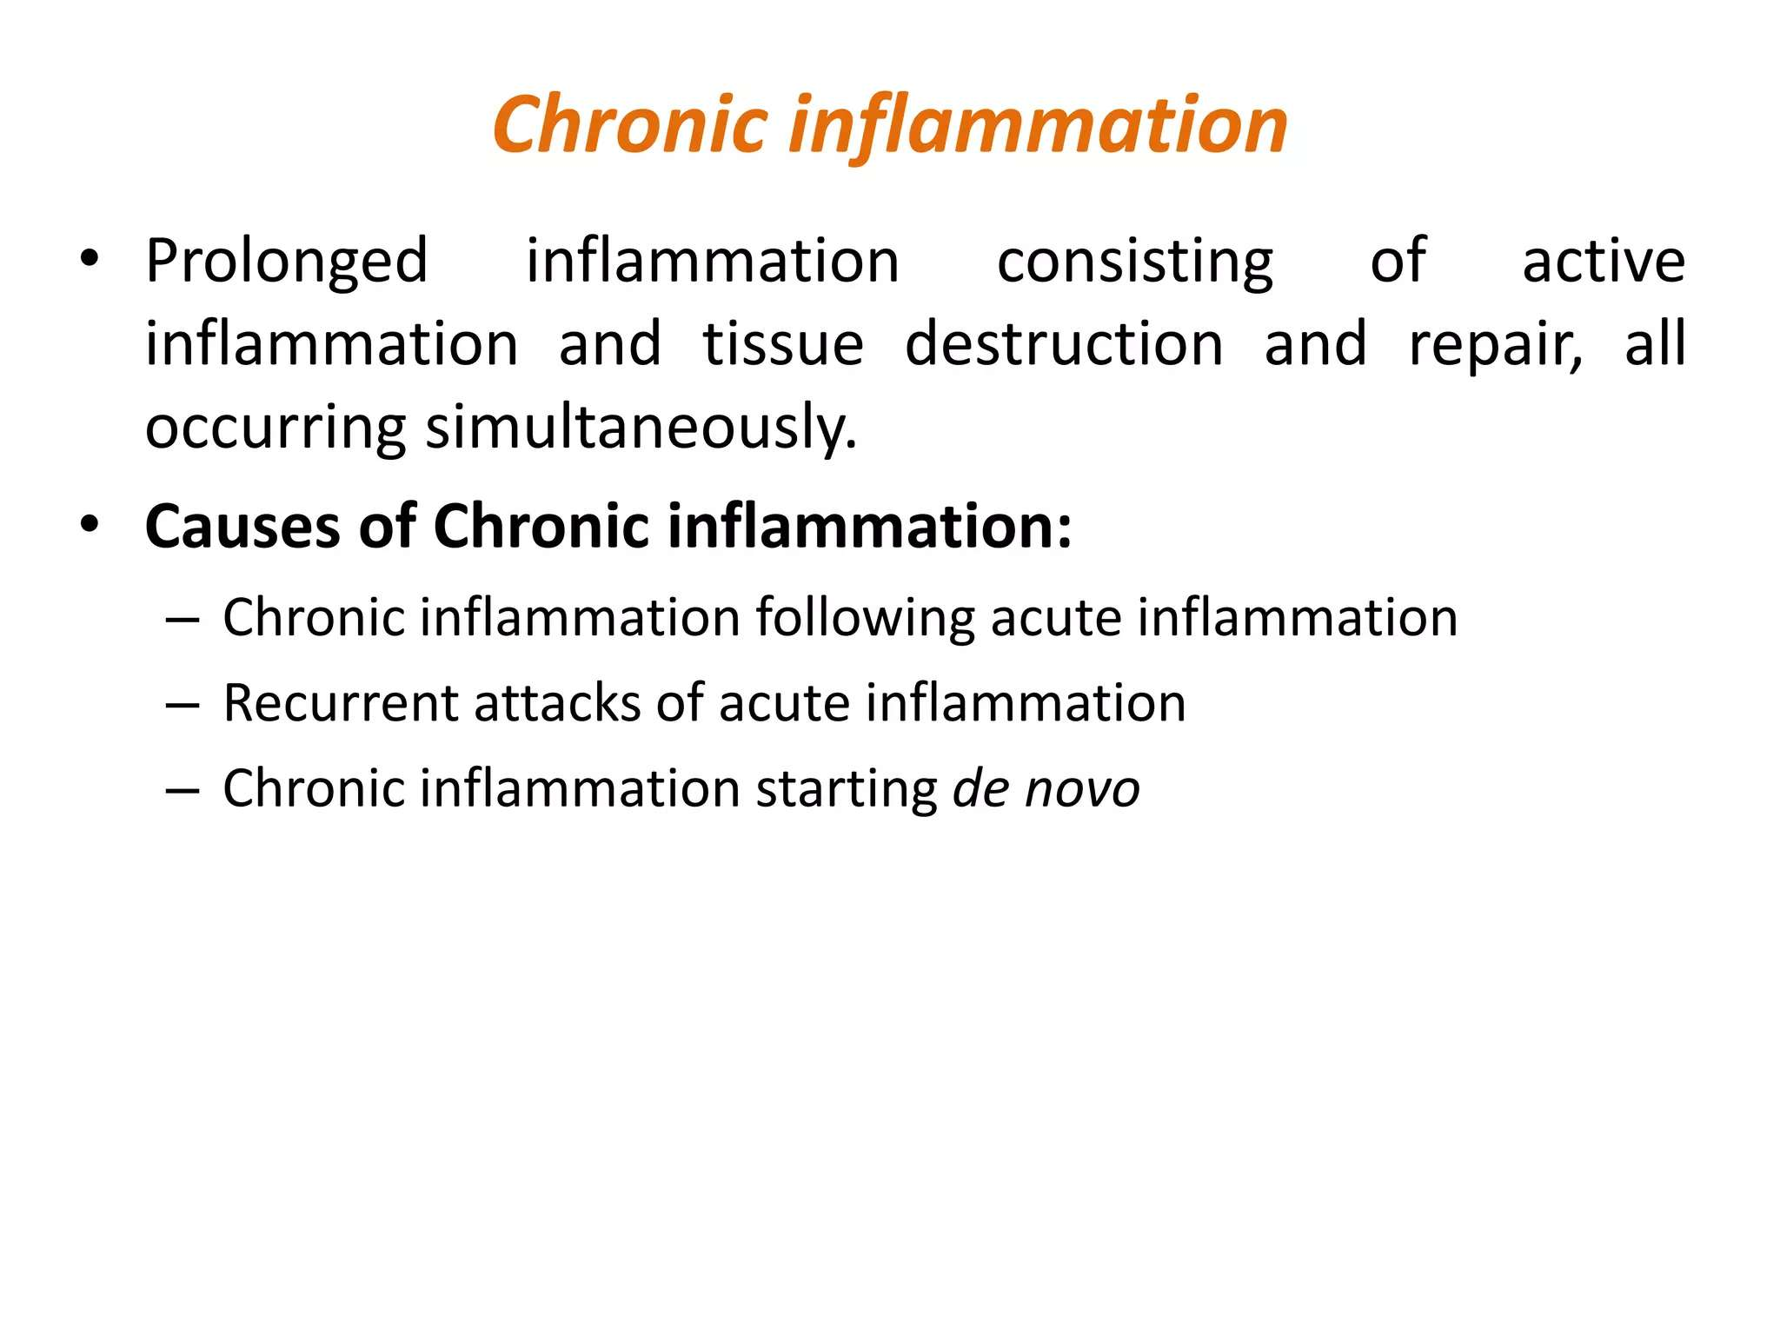

Slide 34
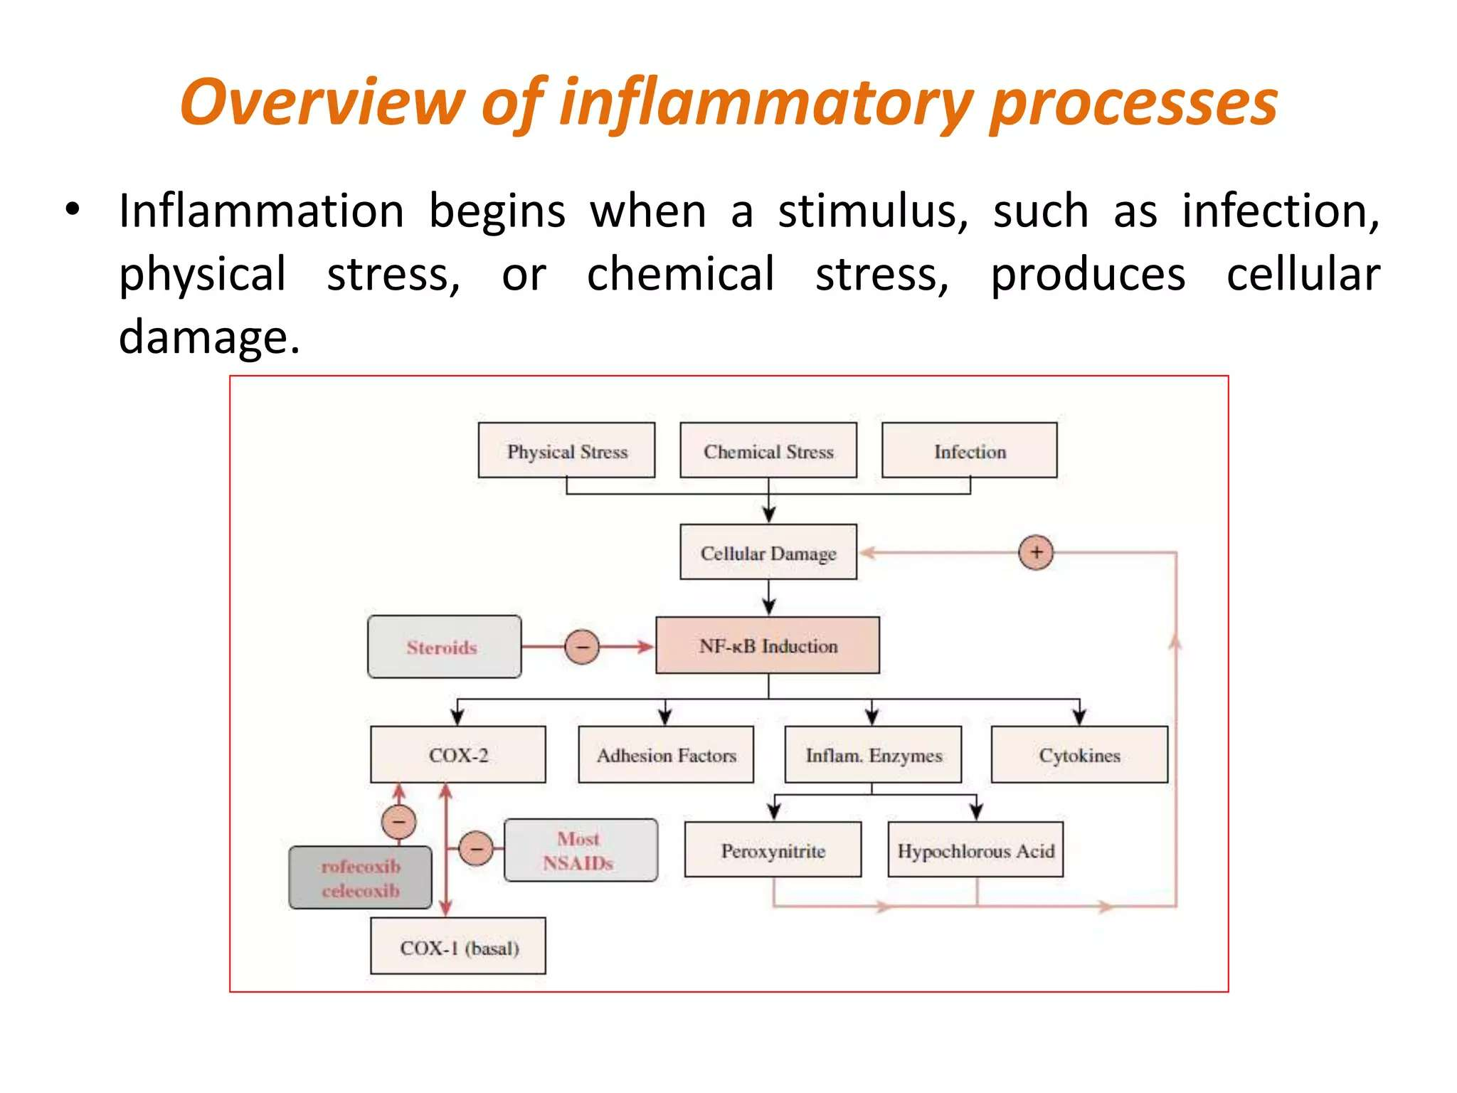
Ayurvedic View of Inflammation
The concept of shotha where
Aama as a toxic waste blocking Srotas (micro-channels) is believed to be the root cause of metabolic and degenerative diseases.
Etiology (Causes):
Srotodushti: Vitiation or clogging of micro-channels.
Aama: Toxic by-product of improper digestion that obstructs micro-channels and is considered pro-inflammatory.
Classification of Shotha: Divided into Nija (intrinsic) and Agantuja (exogenous) based on cause.
Exogenous Causes: Trauma (Abhighata), allergies, infection (Krimi), toxicity (Visha), burns (Dahana), and climatic changes.
Endogenous Causes: Complications of other diseases, not undergoing detoxification, skin diseases, suppression of natural urges, and improper diet
बाह्याः सिराः प्राप्य यदा कफासृक्पित्तानि सन्दूषयतीह वायुः| तैर्बद्धमार्गः स तदा विसर्पन्नुत्सेधलिङ्गं श्वयथुं करोति||८||

Slide 35
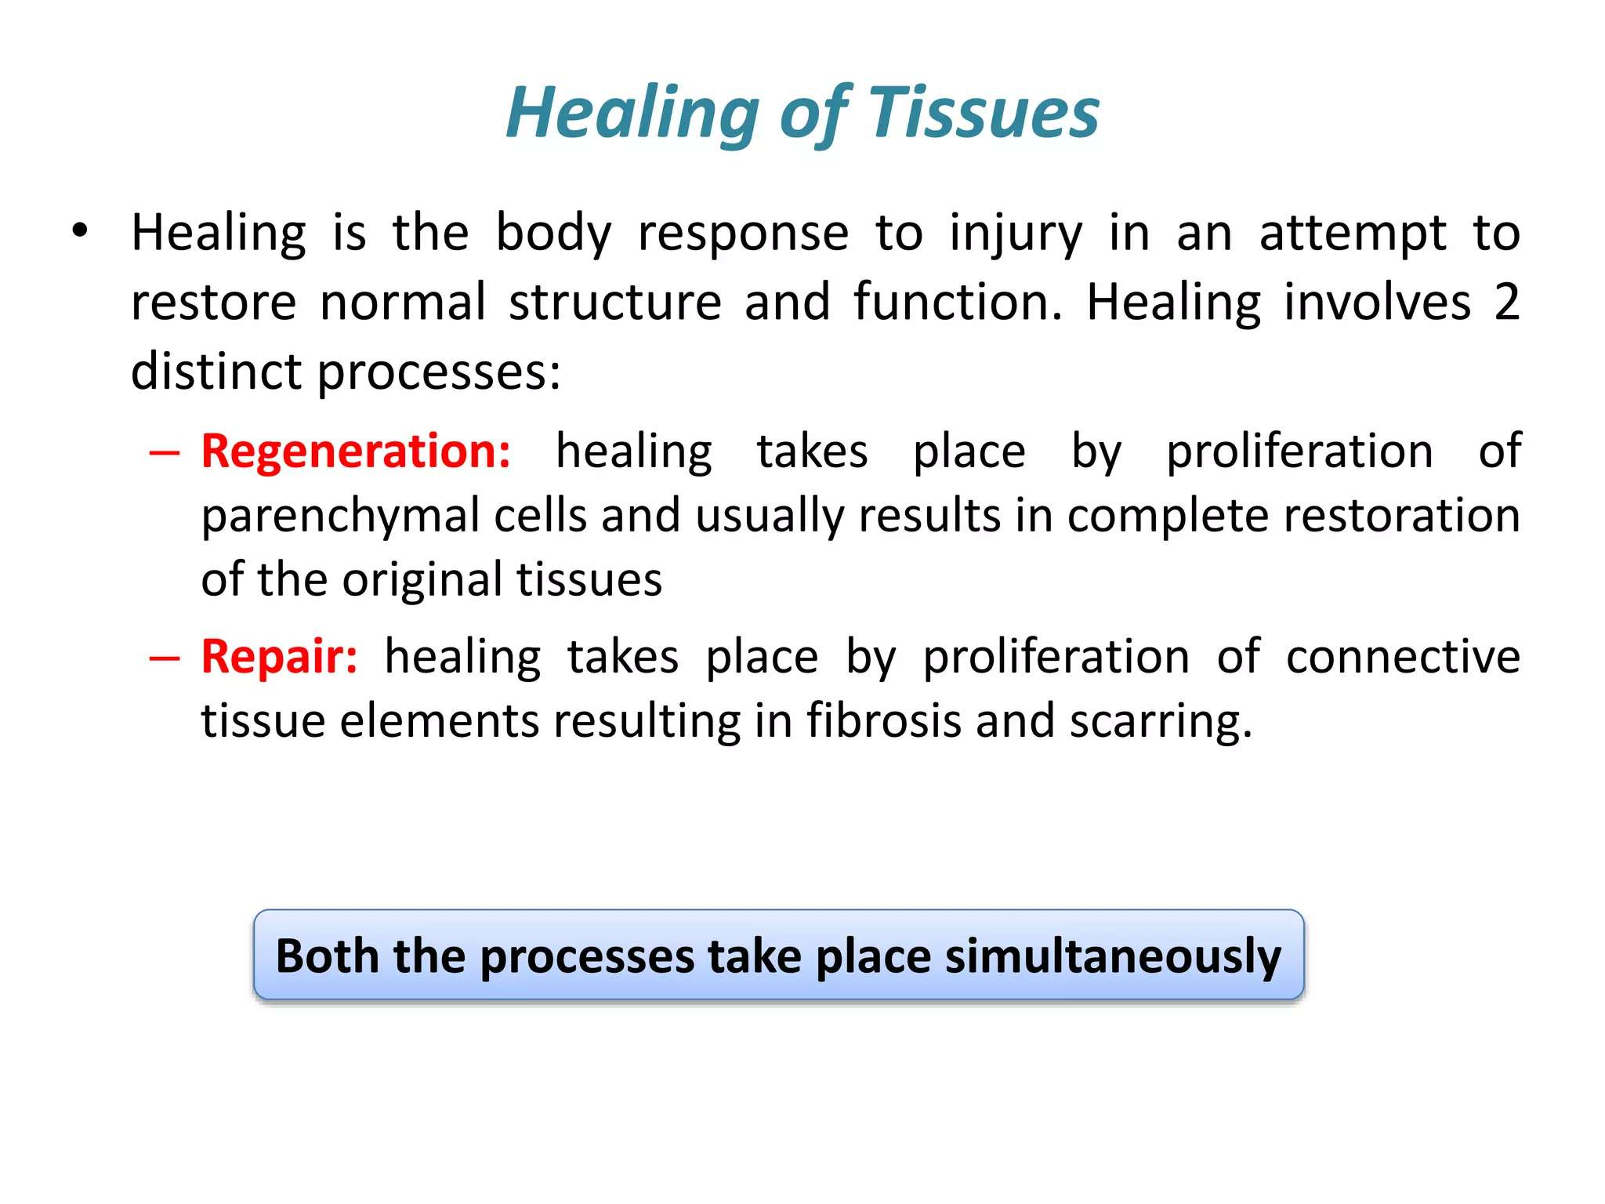
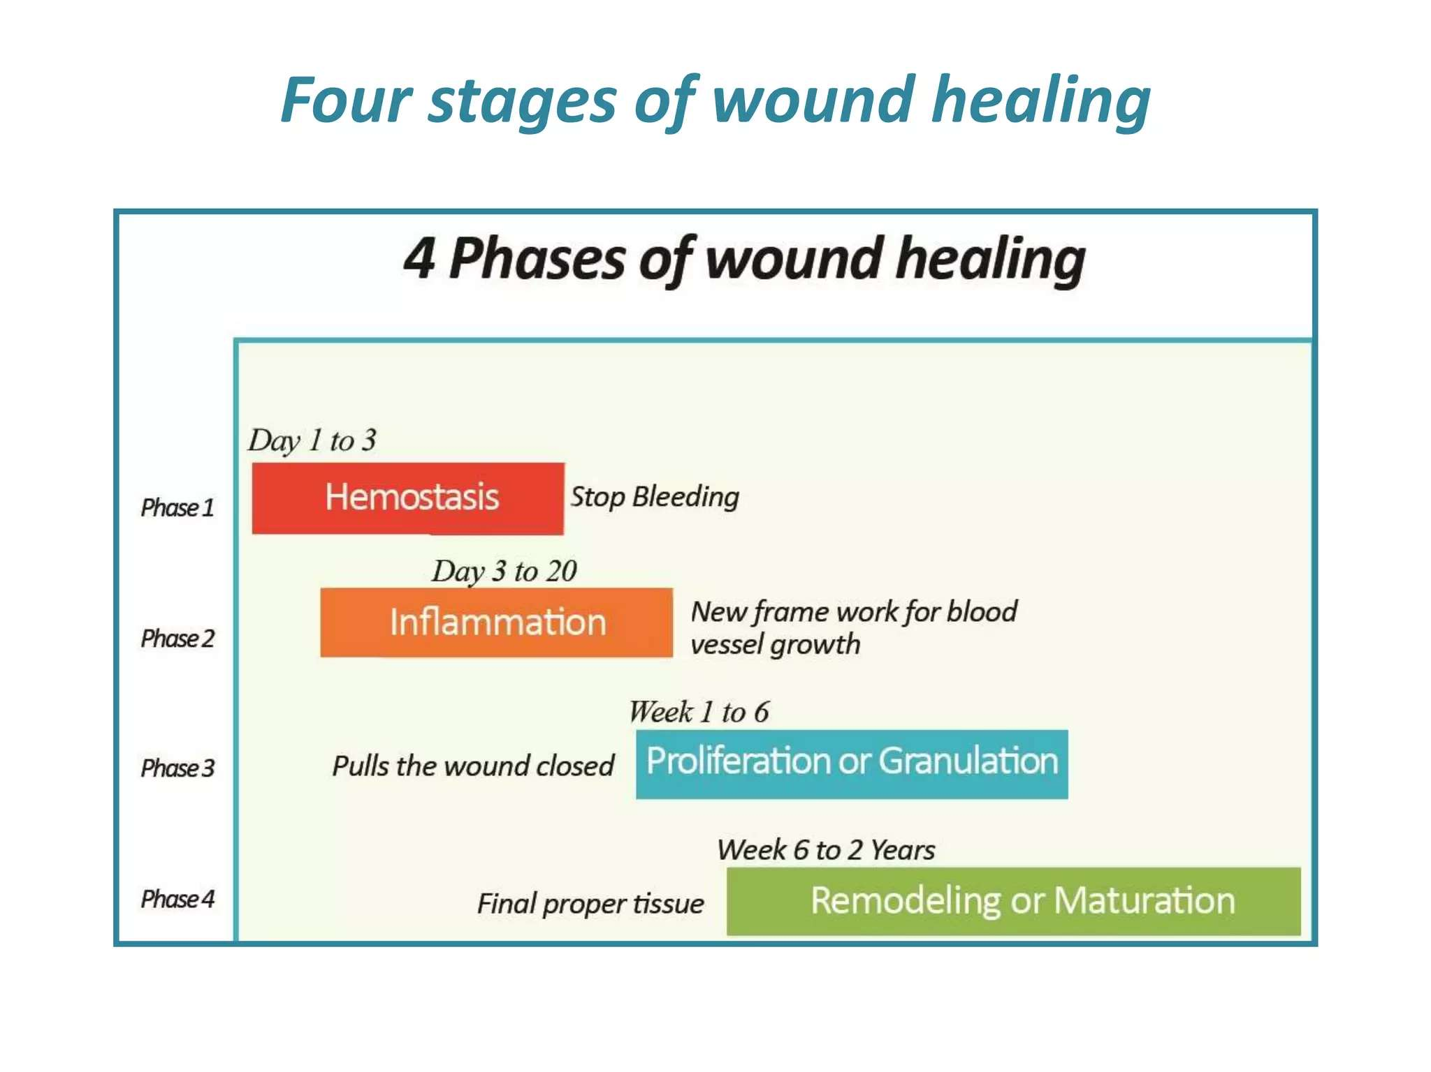
HEALING :

Slide 36
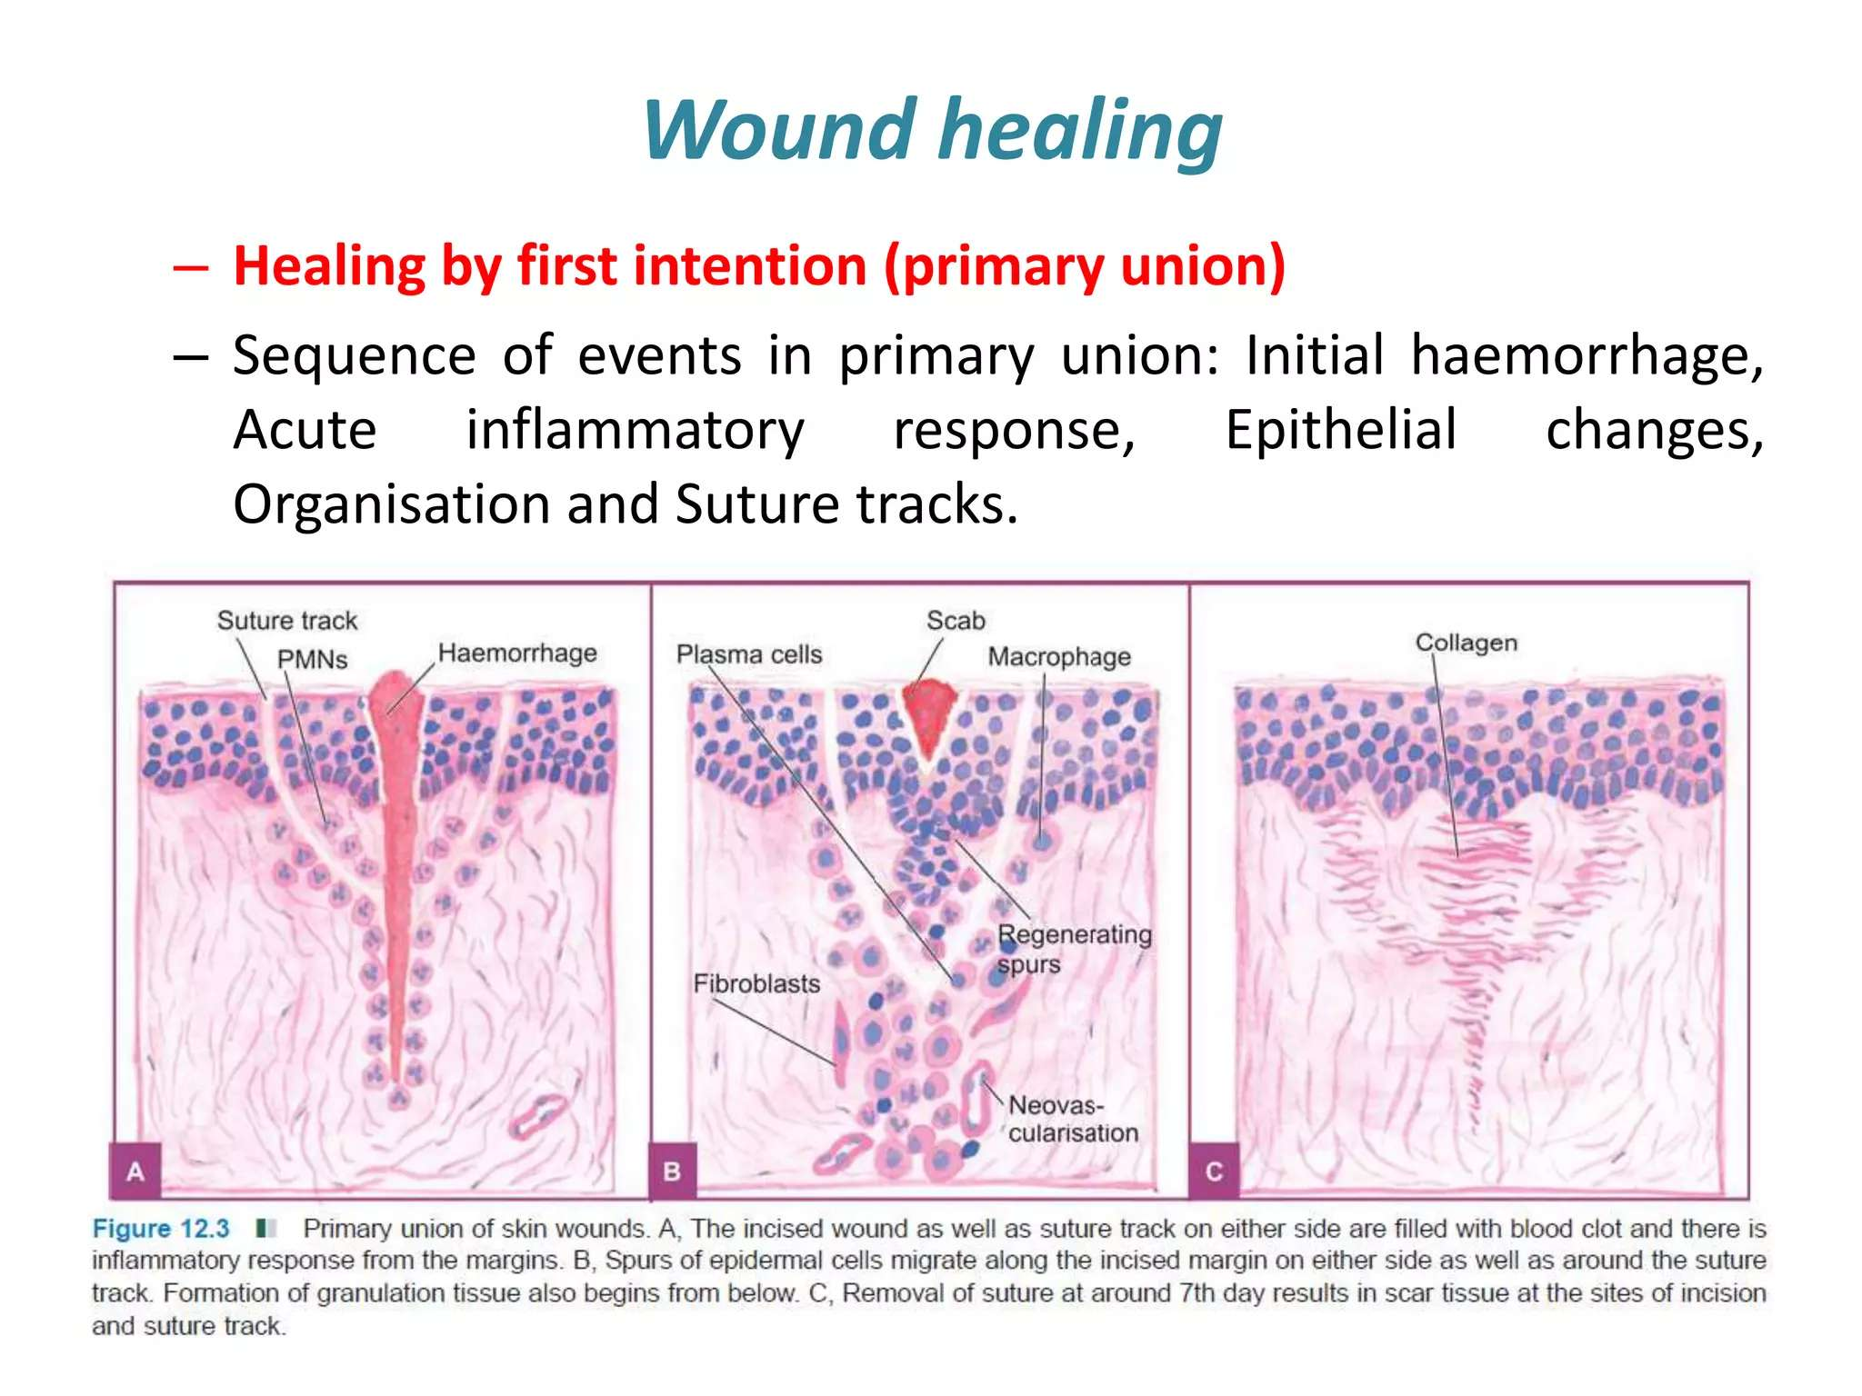
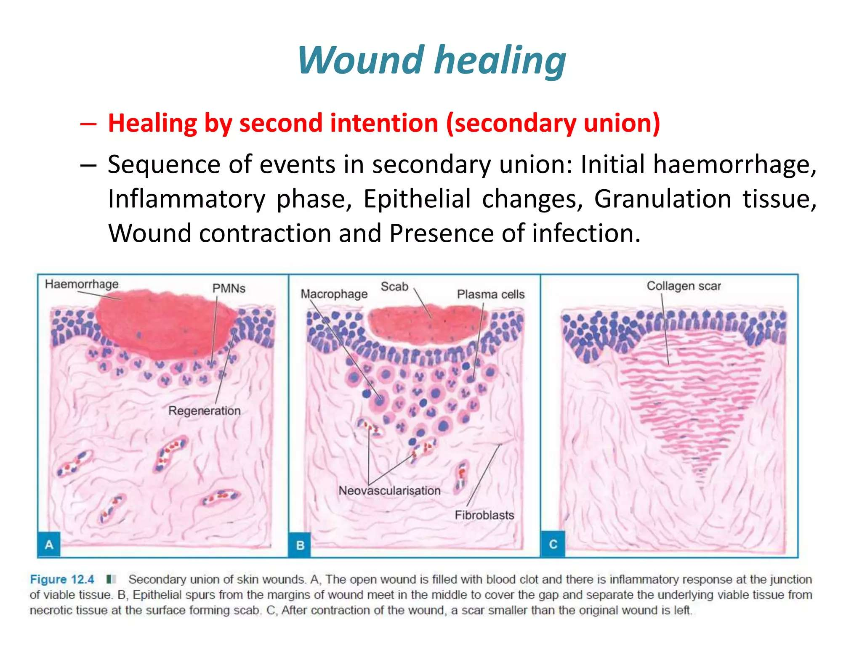

Slide 37
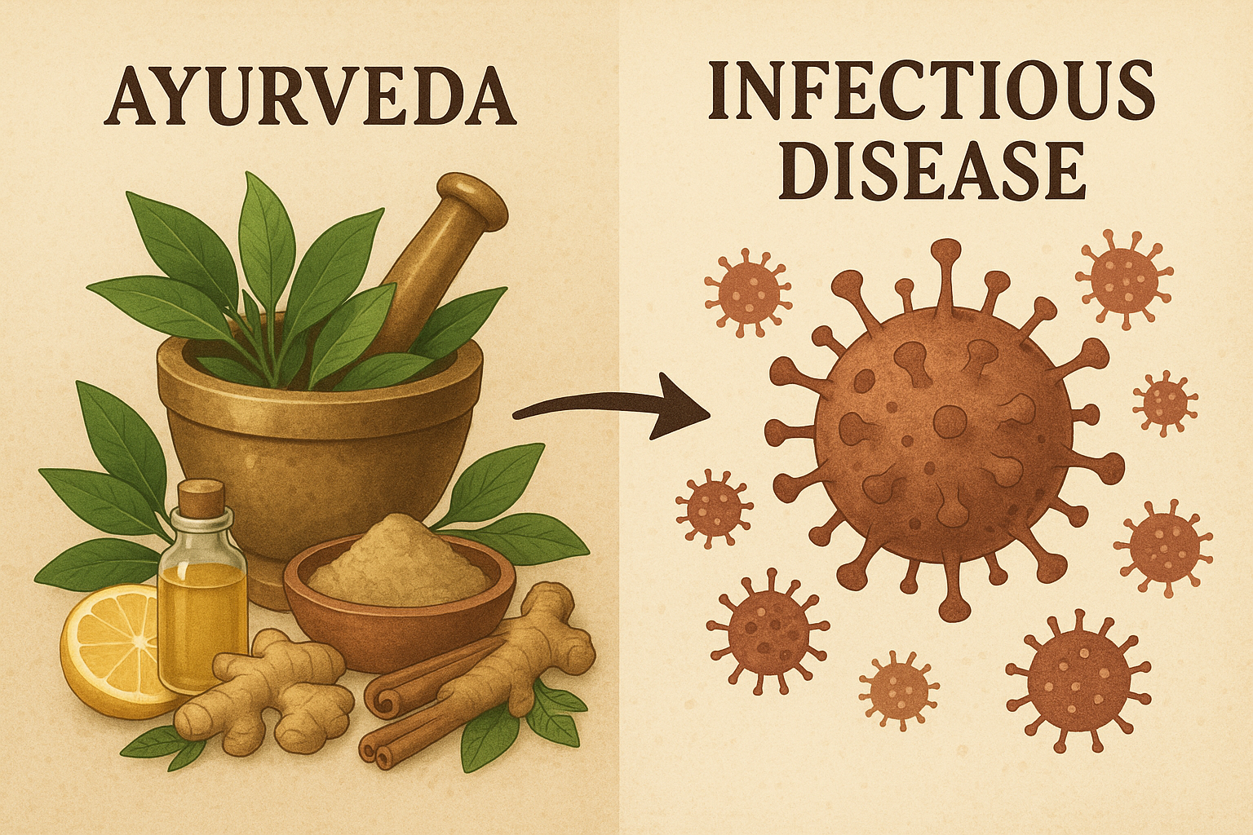
INFECTIOUS AND PARASITIC DISEASEAS IN AYURVEDA:
The concepts of aagantuja vyadhi (exogenous diseases) and krimi (microbes) are closely related to infectious diseases.²
According to Ayurveda, a disease is an altered state of doshas (body elements).³
Even in microbial diseases, the state of the doshas is crucial for the disease's occurrence and management

Slide 38
प्रसंगाद् गात्रसंस्पर्शान्निस्वासात्सहभोजनात् । सहशय्याऽऽसनाच्चापि वस्त्रमाल्यानुलेपनात् ॥ कुष्ठं ज्वरश्च शोषश्च नेत्राभिष्यन्द एव च। औपसर्गिकरोगाश्च संक्रामन्ति नरान्नरम् ॥ (सु सं नि ५/३३-३४)
Acharya Susruta described diseases like kustha (leprosy), jwara (fever), shosha (consumption), and netraabhisyanda (conjunctivitis) as aupsargika roga (communicable diseases).⁵
The text highlights that these diseases can spread through:
All forms of physical contact (prasangad gatrasparsat)
Eating together (sahabhojanat)⁶
Sleeping together (sahayyayasanat)⁷
Sharing clothes, ornaments, and other items (anna vastra malyanulepanat)
This demonstrates an early understanding of the concept of infection and contagion

Slide 39
The Charaka Samhita identifies four factors responsible for janpadodhwansha (epidemics or destruction of a community):
Vayu (air)
Udaka (water)
Desha (location/land)
Kala (season/time)
Ayurveda emphasizes that the body's immune system (bala) is more important than the infectious organism itself.
The strength of the disease (bala of vyadhi) depends on the strength of the cause (nidana), the doshas, and the dushya (vitiated tissues).

Slide 40
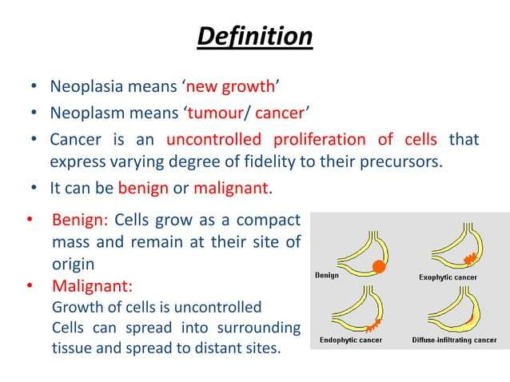
NEOPLASM IN AYURVEDA :
Ayurvedic Classification of Neoplasm
Group I: Clear malignancies like arbuda and granthi. Examples include mamsarbuda (melanoma) and raktarbuda (leukemia).
Group II: Diseases considered as cancer, such as incurable ulcers and tridosaj gulmas (abdominal tumors).
Group III: Diseases with a possibility of malignancy, such as Visarpa (erysipelas) and asadhya kamala (incurable jaundice).

Slide 41
Causes and Pathogenesis
Causes (Sushruta): Pathogens affecting the sixth layer of skin (Rohini), muscular tissues, and blood vessels. These are caused by lifestyle errors, unhealthy foods, poor hygiene, and bad habits.
Vitiation of doshas:
Vata: Aggravated by bitter, pungent, astringent, dry foods, and stress.
Pitta: Aggravated by sour, salty, fried foods, and anger.
Kapha: Aggravated by sweet, oily foods, and a sedentary lifestyle.
Pathogenesis: Explained on the basis of Tridoshas.
Decreased dhatwagni (metabolism) leads to excessive tissue growth.
Cancer originates from a metabolic crisis, where Vata (anabolic phase) is aggravated and Kapha (catabolic phase) is suppressed.
Six Stages of Pathogenesis (Sushruta):
Sanchaya: Early localized neoplastic changes.
Prakopa: Transformation of primary growths into metastatic tumors.
Prasara: Metastasis.
Sthana samsraya: Secondary growth and complete metastasis.
Vyakti: Clinical signs and symptoms appear.
Bheda: Differentiation of growth based on histopathology.

Slide 42
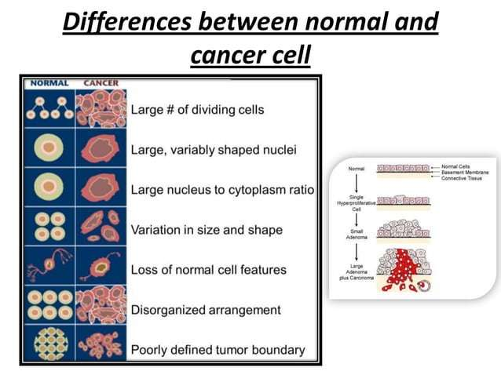
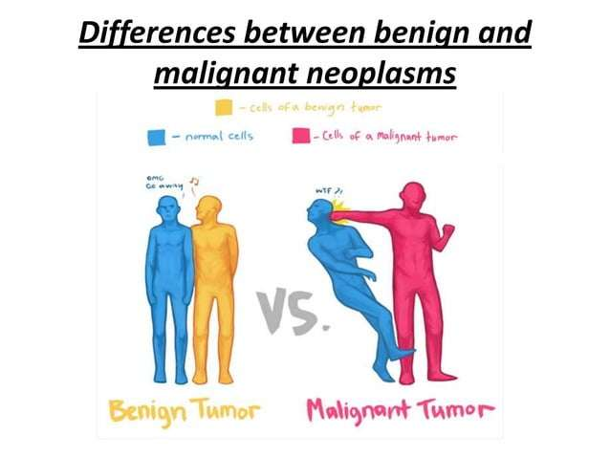

Slide 43
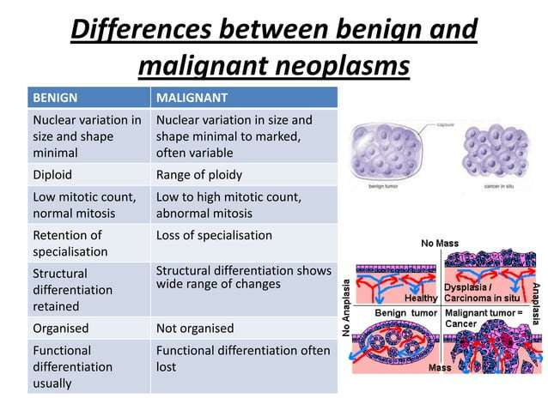
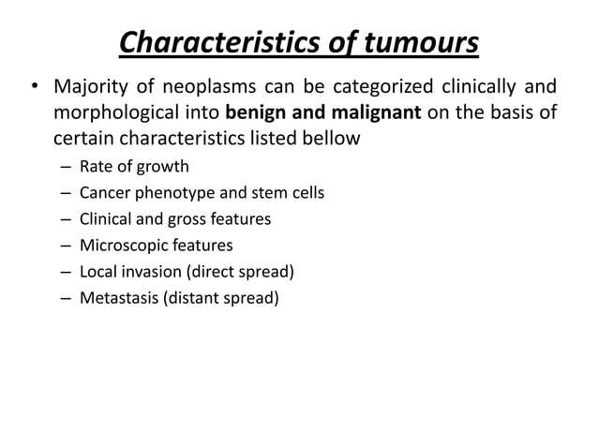

Slide 44
ENVIRONMENTAL AND GENETIC DISORDERS :AYURVEDA ASPECT
Genetic (Bīja Dosha / Bīja-Bhaga-Dosha)
Bīja = sperm/ovum,Bīja-bhaga = parts of genetic material.
Defects in Shukra (sperm) and Artava (ovum) lead to congenital disorders or Sharīraja Vikāra. These can manifest as anatomical, physiological, or mental defects in the progeny.
Example (Applied Pathology):
Recurrent abortions due to chromosomal abnormalities = linked to Beeja-dosha
Mental retardation or congenital anomalies like cleft palate = Sharīraja vikāra

Slide 45
Environmental Factors (Āhāra, Vihāra, Desha, Kāla)
Desha (geographical region), Kāla (seasonal variations), and Āhāra-Vihāra (diet/lifestyle) affect dosha prakopa.
These influence Agni, Dhatu formation, and ultimately cause disease if not balanced.
Example (Applied Pathology):
Urban, sedentary life with heavy food → Kapha aggravation → Diabetes mellitus (Prameha)
Dusty, dry environment (Rūksha, Vāta-prakopaka) → Asthma (Tamaka Shwāsa)

Slide 46
Kāla (time) is a causative factor for degeneration (Jara)
As age advances, Vata increases, Dhatus decrease, leading to diseases of depletion
Example (Applied Pathology):
Osteoarthritis as a natural consequence of Asthi dhatu kshaya and Vata vriddhi
Neurodegeneration / Parkinson’s = Majja kshaya + Vata vitiation
Integrated Tridoshic Mechanism
Beeja dosha (genetic) predisposes
Kāla (aging or seasonal) precipitates
Āhāra-vihāra / environment modulates the expression

Slide 47

Thank You

